Slide 1
Indus River Valley

Slide 2
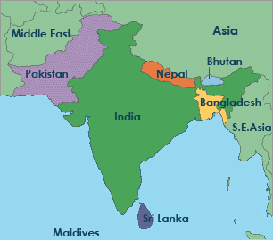
Indus River Valley
The Indus and Ganges rivers are located in present day INDIA and PAKISTAN.
Together India, Pakistan, and Bangladesh form the Indian Subcontinent.
Subcontinent – a large area of
Land that is part of a continent,
but is also separated from the
continent

Slide 3
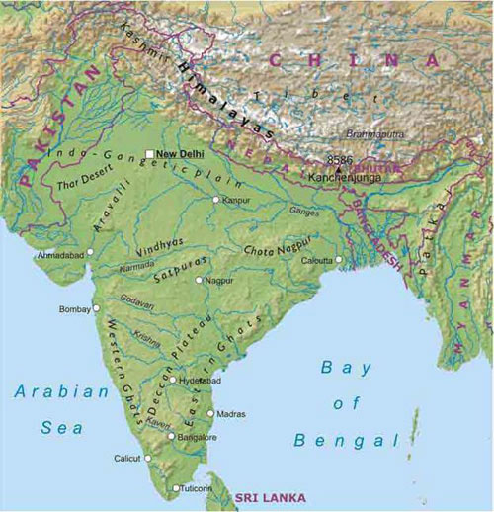
Geography of India
The Indus and Ganges Rivers make up a fertile plain similar to that of Mesopotamia.
On India’s Northern border are the tallest mountains in the world… the Himalayas.
On India’s Southern border is the Arabian Sea and the Indian Ocean.

Slide 4
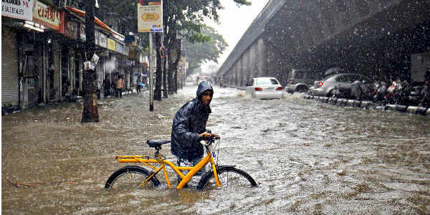
India’s Climate
India is affected by Monsoons, which brings seasonal winds and usually heavy rainfall in the Summer months and an extremely dry spell during the Winter months.
If the summer monsoon fails to bring large amounts of rain then crops often fail in the interior of India.

Slide 5
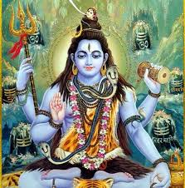
Early Indus Culture
The early settlers called the Harrapans of the Indus River valley had their own written language, and a planned city.
Uniform Religion
Theocracy
Links to modern Hindu – depictions of Shiva hints that even ancient Indian people practiced Hinduism.
(We will get into Hinduism later ☺)

Slide 6
So… What happened to ancient Indian societies?
Scientists believe that early tectonic activity (earthquakes) disrupted the flow of water of the major rivers and destroyed villages.
Earthquakes also caused the water supply to dry up in areas that previously had a steady supply of water.

Slide 7
Indo-Europeans
Indo-European- group of nomadic peoples who may have come from the steppes
Tamed horses, herded cattle, had language
Eventually migrated away from steppes
Steppes- dry grasslands north of the Caucasus Mountains

Slide 8
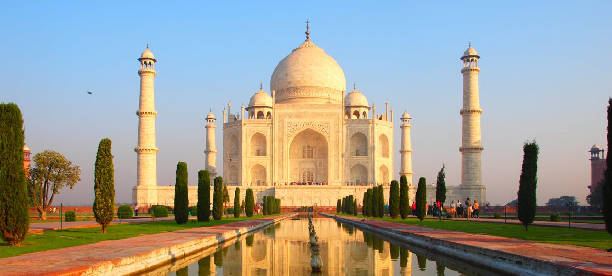
Ancient India

Slide 9
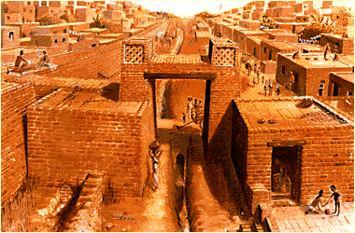
Indian City

Slide 10
Aryan Invasion
Aryan people occupy India before 2000 B.C.
Vedas- Aryan sacred literature
Collection of prayers, magic spells, rituals, info on the gods
Epic Mahabharta showed the struggles of the Aryan Kings

Slide 11
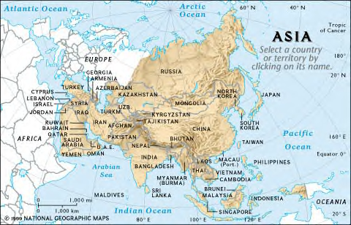
Aryan Invasion
The route of the Aryans into India.

Slide 12
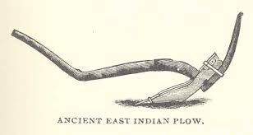
The Aryans learned to use iron after their invasion of India.
Iron was uses to make plows which made farming much easier.
It was also use to make iron weapons which the Aryans used to carve out more territory in the Ganges River basin
Soon cities ruled by chiefs called Rajahs arose
By 500 B.C., the Aryans had built a new Indian civilization

Slide 13
Culture Mixes
The Aryans brought with them their own language, called Sanskrit and religious and cultural beliefs.
Aryan culture mixed with native Indians
Hinduism, the major religion of India, was a mixture of Aryan and Indus Valley beliefs.
The caste system, which keeps people in strict social classes, was brought to India by the Aryans.

Slide 14
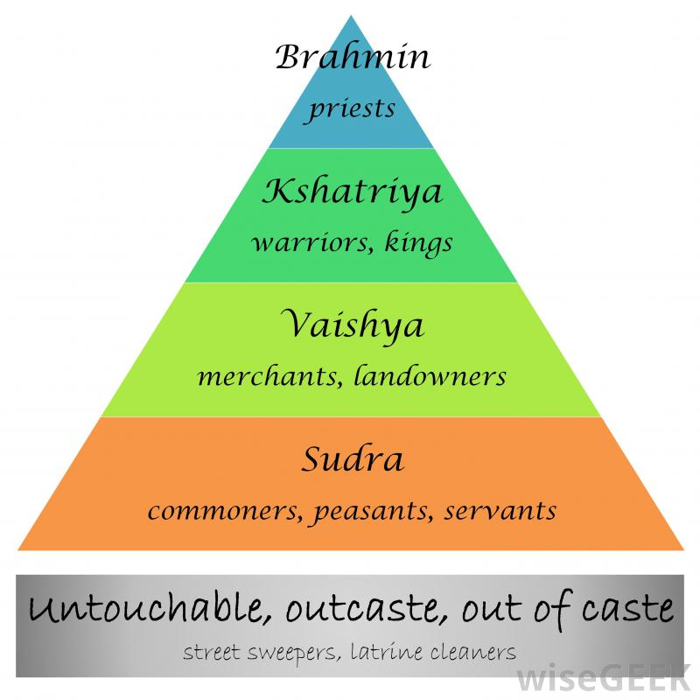
A person’s place in society determined by their caste, or social class.
In Hindu tradition people are not created equal. They are categorized at birth into one of the 4 ranks of society, known as varnas.

Slide 15
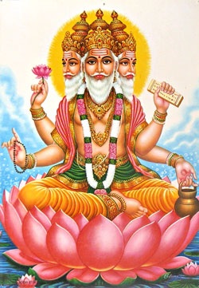
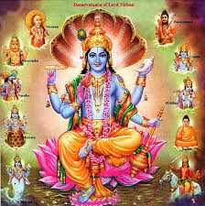
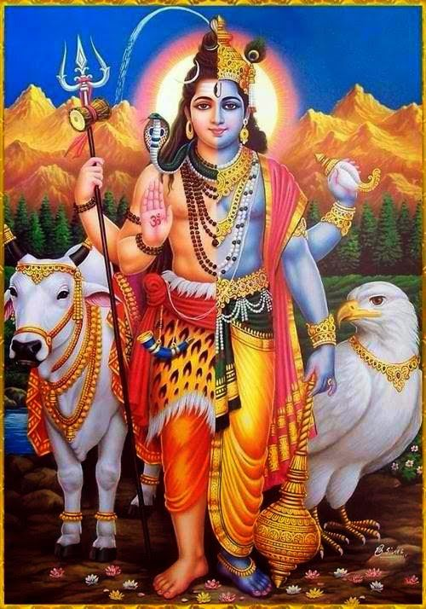
Hinduism
More than 1 billion people follow Hinduism
It has no written rules and no single prophet or religious leader.
It is a Pantheon: an assembly of gods
Polytheism
Hindus believe that all gods, mortals, and everything in the universe is of one immortal essence or spirit.

Slide 16
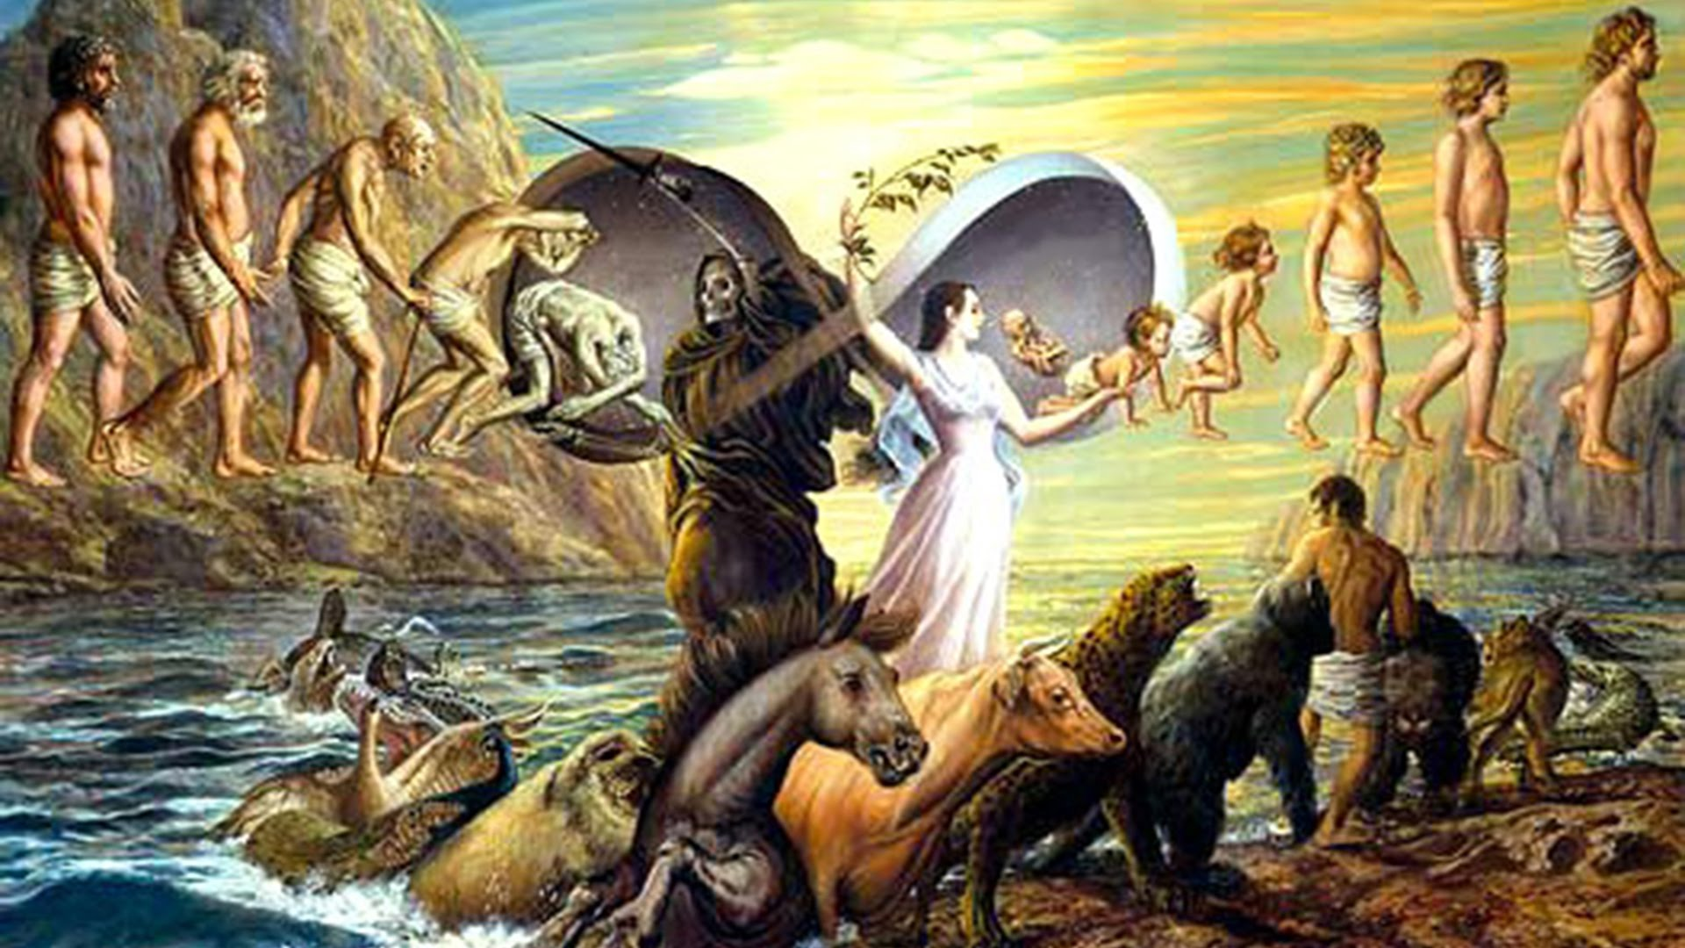
Reincarnation and Karma
Many Hindus believe in the concepts of Karma and Reincarnation.
Karma is the Sanskrit word meaning action.
Reincarnation is also known as the transmigration of souls. One’s actions, or Karma in this life influence one’s rebirth and future life.
A person with good karma will be reborn into a higher caste.

Slide 17
Hindu Trinity (trimurti)
Brahma - the Creator
Vishnu - the Preserver
Shiva - the Destroyer
Three aspects/powers of the same divine being
trinity

Slide 18
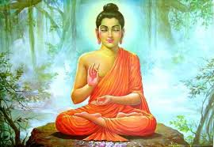
Buddhism: The search for Enlightenment
Buddhism was founded in India by Siddhartha Gautama, a young prince who gave up a life of wealth and privilege to search for spiritual peace.
Buddha means “ Enlightened One” a term given to Siddhartha by his followers.
Buddha came to believe that life is an endless cycle of suffering caused by the desire for Earthly goods.
The way to master this desire was to practice yoga, a practice including meditation, self-denial, postures, and non-violent behavior.
Buddhism rejects the Caste System

Slide 19
Buddhism's teachings: The Four Noble Truths

Slide 20
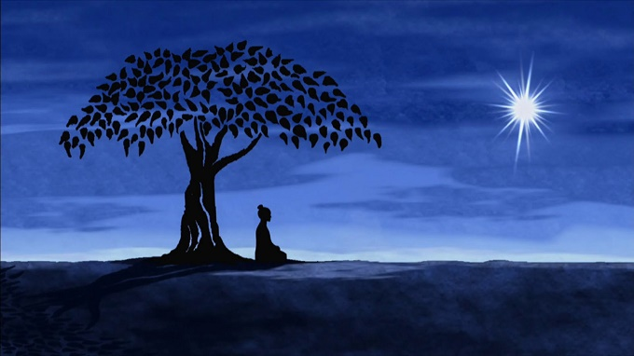
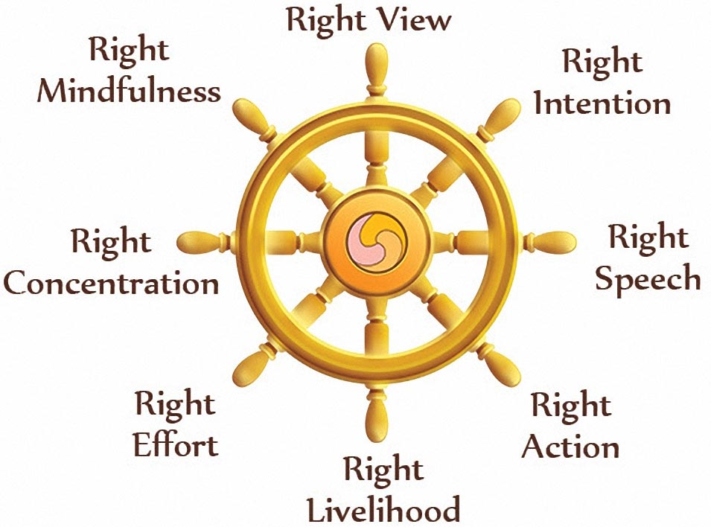
Nirvana
By following the Eightfold Path, anyone can reach Nirvana
Nirvana: Release from selfishness and pain
Hinduism and Buddhism are very similar

Slide 21
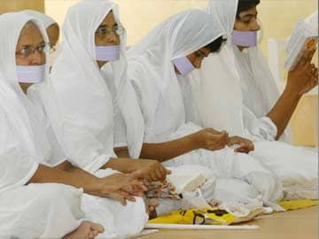
New Religions Arise: Janis Dharma
Jainism: followers of this religion believe that everything has a soul, and so should not be harmed.
Nonviolence (even to ants)
Tolerance of other religions
5 million in India today

Slide 22
After the death of Buddha, Buddhists divided into to groups.
Mahayana – offered salvation to all and popular worship and rejected the self denial Eightfold Path.
Theravada – those that held on to the old ways of trying to overcome desire through self denial.
Buddhism's popularity causes a shift away from embracing hundreds of Gods in Hinduism.

Slide 23
Indian Trade
Silk Roads – vast trade network from China to… Rome (Europe) and Africa.
Was called the silk road due to the export of silk from China.
http://www.youtube.com/watch?v=vfe-eNq-Qyg
Trade caused cultural diffusion or ideas to spread.
Indian people became professional middlemen, facilitating trade between China and Europe and Africa.
Similar to E-Bay. Amazon. etc.

