Slide 1
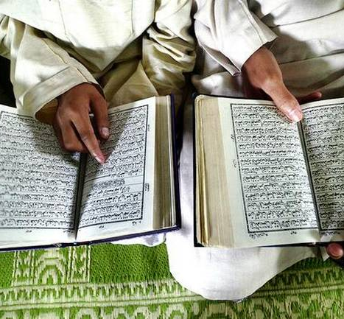
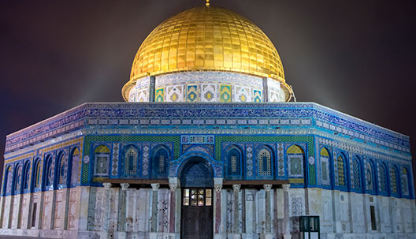
CH. 8 Islamic World Through 1450

Slide 3
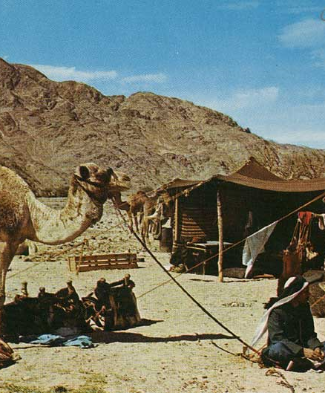
Bedouin Culture
Arabic Peninsula prior to Islamic Revelations (Quran): Inhabited by Bedouins—mostly nomadic, tribal, polytheistic, practiced polygyny, and their tribes were ruled by a Sheikh.
Many are merchants leading caravans across the dessert
The peninsula is at the crossroads of trading routes- camel caravans, the Mediterranean Sea, Red Sea, and Indian Ocean.
Trade brought tribes with monotheistic Jews, Christians, and Zoroastrians.

Slide 4
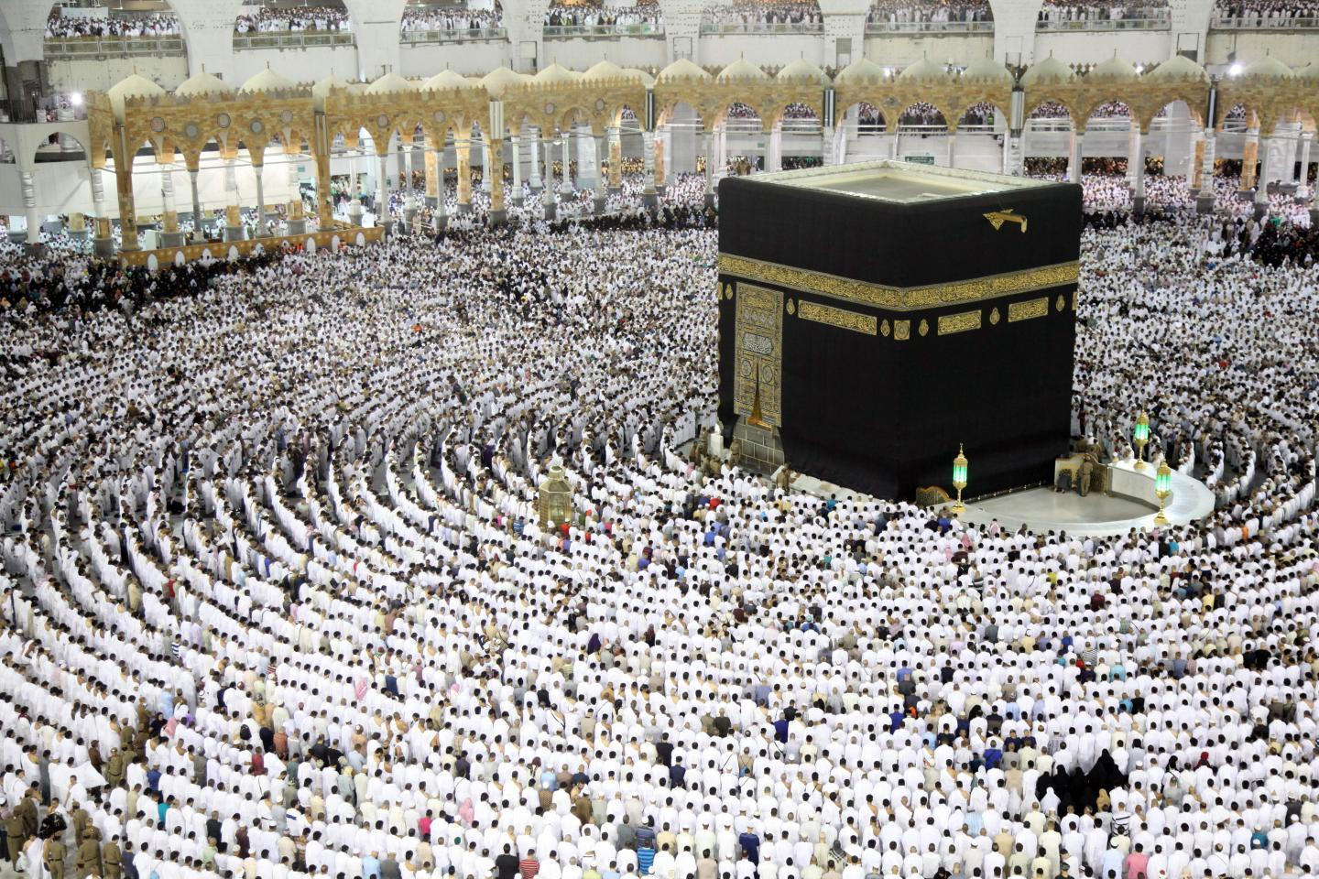
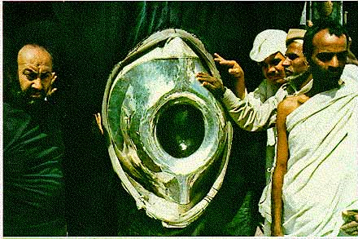
Bedouin Culture
Contact with monotheistic religions: Some Arabs saw the deity Allah as the main god, even linked him to the Jewish Yaweh, and the rest were thought as being idols.
Thus, they came to see themselves as “children of Abraham” and many moved towards converting to Judaism or Christianity by the 600s.
Also part of their beliefs was veneration was a large black stone in Mecca, tribal values of generosity and honesty=> Continuity of this traditions into Islam. (Except polytheism)
Kaaba in Mecca and the Black Stone

Slide 5
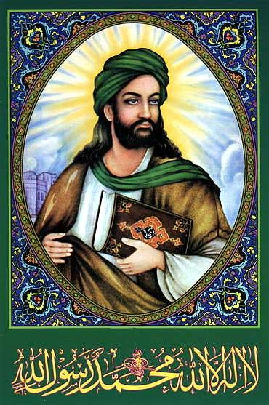
Muhammad and Islam
Born Muhammad Ibn Abdullah 570-632 (around the same time as Justinian was ruling)
Orphan as a child, raised by uncle. As a child worked as a shepherd, became a self-made merchant, married a wealthy widow, and then settled in Mecca where he was bothered by injustice.
610 Muhammad had a series of revelations that he attributed to an angel of the deity Allah (revelations later collected in the book Quran or Koran, meaning “recitation”).

Slide 6
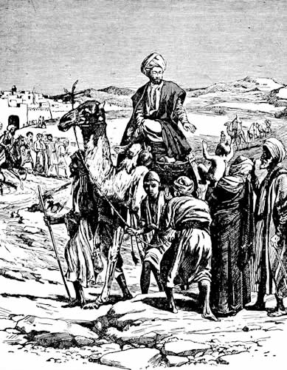
Messenger and the Message
“Seal of Prophets”: In Islam, Muhamad is the final prophet in a series of Judeo-Christian prophets. A big stress on the finality of Muhammad’s message.
Previous prophets were mistaken and corrupted religion– Jews seen as arrogant for believing they were the “chosen people” and Christians wrongly turned their prophet into god.
At beginning, Muhammad left for Medina (hegira), as he was being persecuted there.
Later, he came back to Mecca and made the Ka’aba a shrine of Islam
Muhammad united all of the Arabian Peninsula under Islam

Slide 7
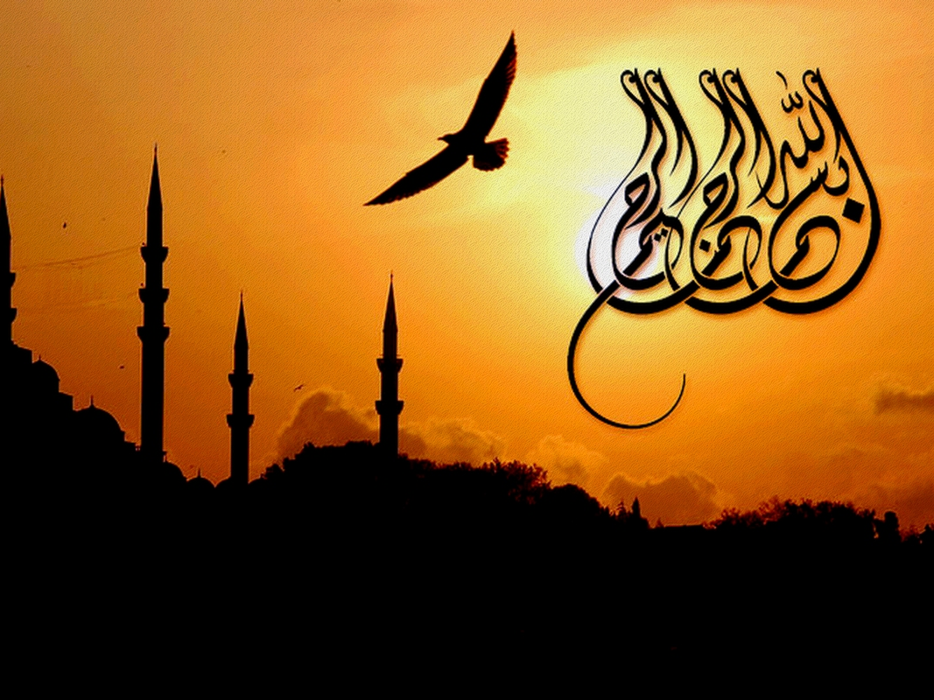
Core beliefs of Islam
Monotheism, one of the three Abrahamic religions
Respect to People of the Book –Jews and Christians
Submission to Allah, Quran the sacred book—guidance and laws
Greater and Lesser Jihad or struggle–greater struggle with one self is overcoming greed or sinful desires, lesser struggler of the sword is to protect the community from external threats.
Five Pillars of Islam
Sharia—developed after Muhammad’s death, outlines behavioral requirements for daily life—bans on eating porn, gambling, drinking alcohol.

Slide 8
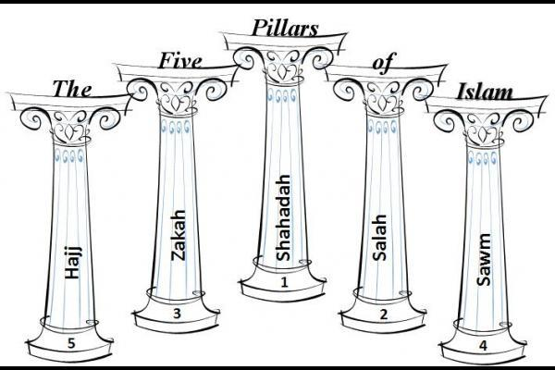
Five Pillars of Islam
The Revelations required five actions from pious (devout) Muslims:
Sahada: Faith, declaration of Allah as the one true God and Muhammad as his prophet
Salah: Prayer, Daily prayer five times a day
Zakat: Alms-giving Giving to charity
Sawm: Fasting during the month of Ramadan
Hajj: Pilgrimage to Mecca
These requirements show the linkage of the spiritual and social.

Slide 9
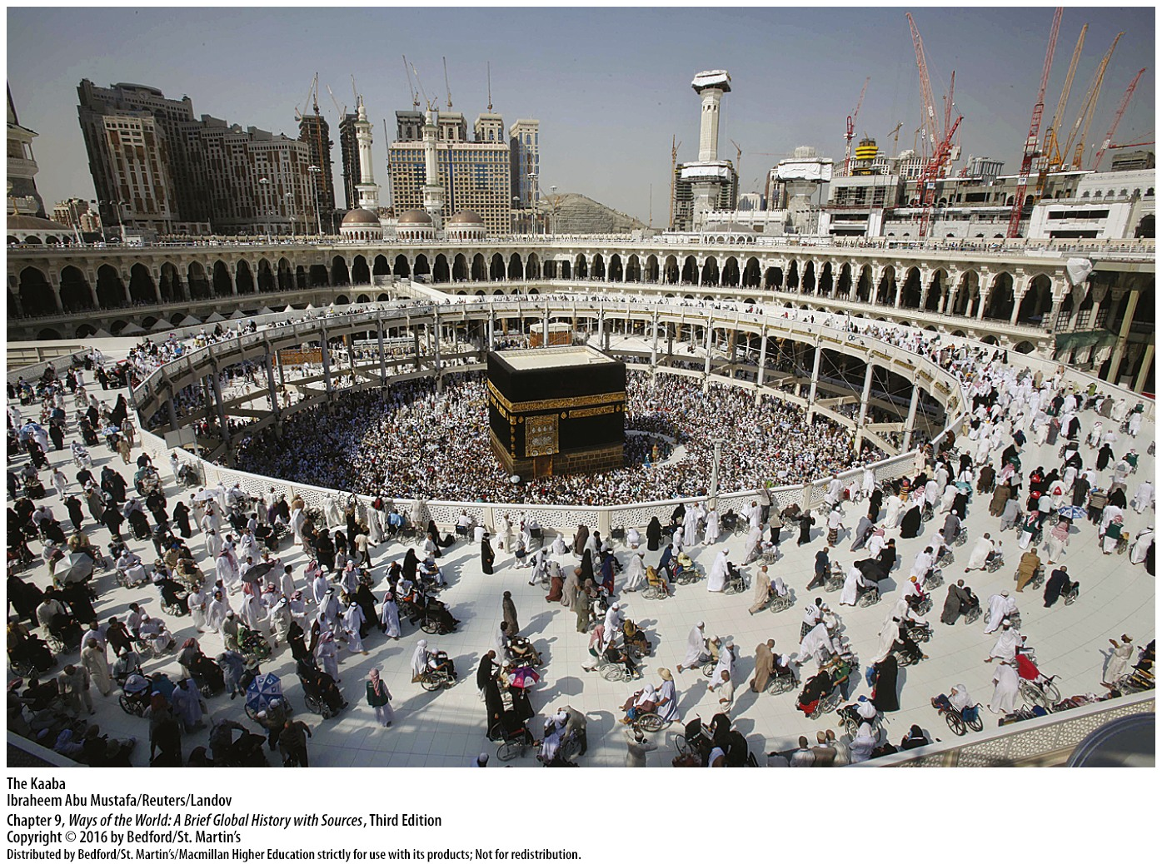

Slide 10
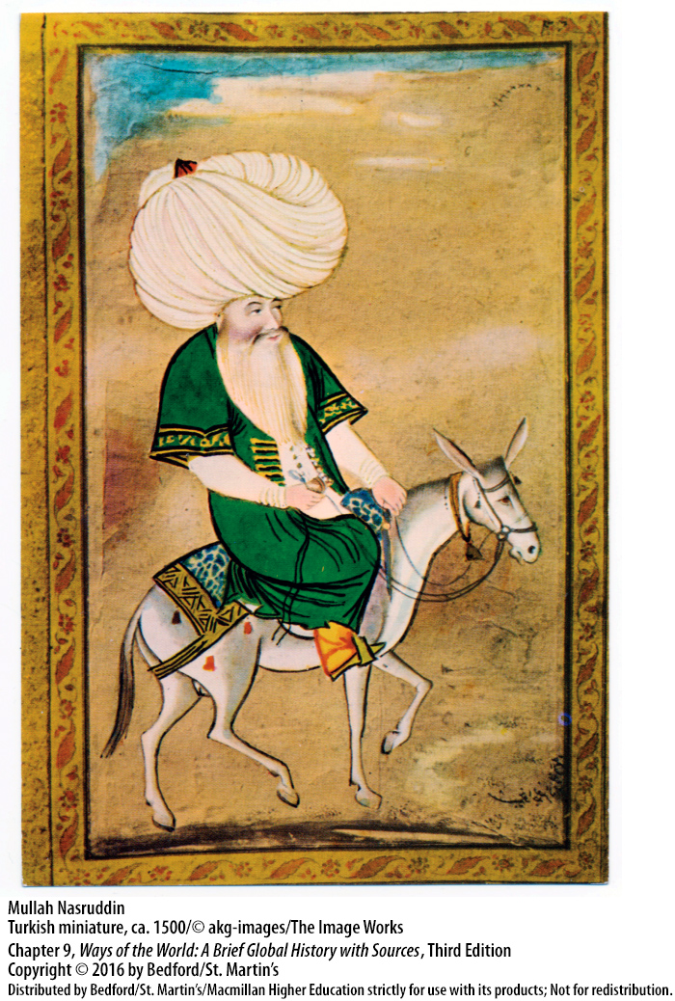
Why did many convert to islam?
One of the main reasons is that Islam had a message of equality which many religions at the time did not call for.
Many wealthy merchants were Muslim, bringing a sense of status (Muhammad had been a merchant after all)
Another reason is that by converting to Islam, you avoid the jizya or the tax to non-Muslims
Another reason is that in some instances, such as in the Turkic Sultanates, Muslims were treated way better than non-Muslims

Slide 11
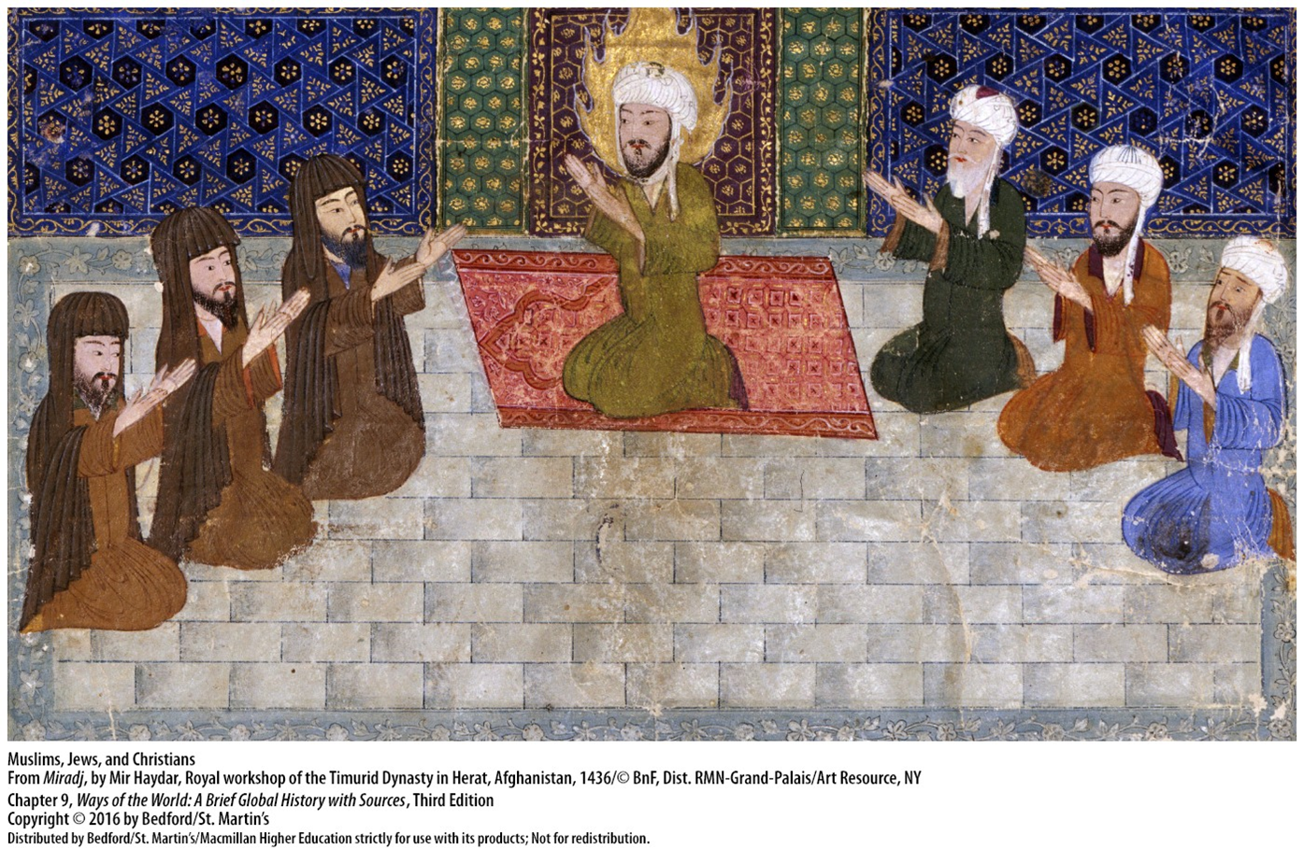

Slide 12
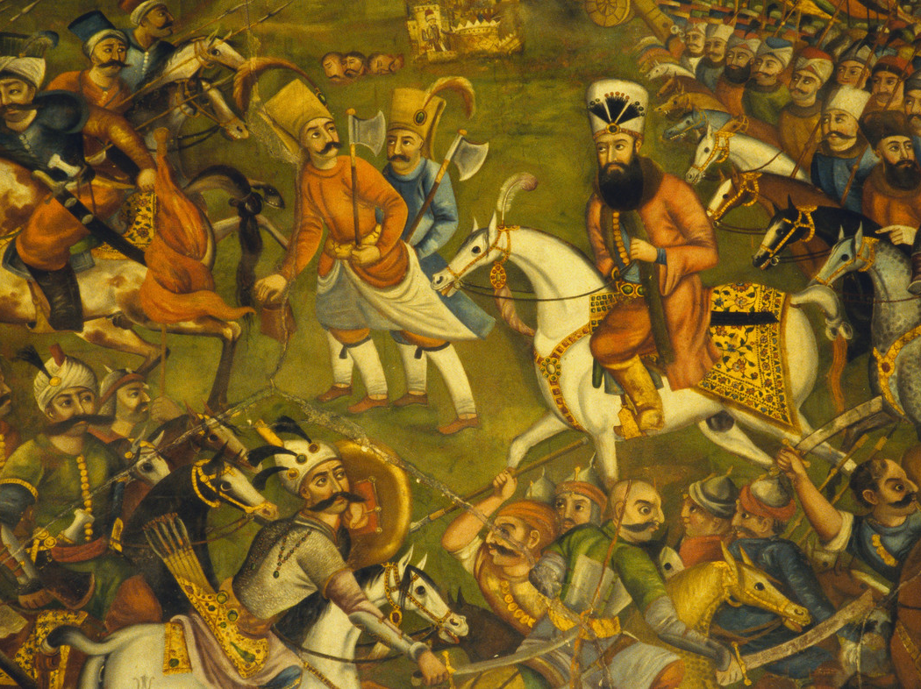
First Four Caliphs and Civil War
After the death of the Muhammad, disputes arose over who should lead the Muslim community or Umma.
Abu Bakr– supported by a faction known as Sunni—leaders should direct descendants of Muhammad
Ali— supported by the Shia or Shiites—leaders should be from the learned community
At the end the Sunnis became, and still are the majority—Abu Bakr and Ali were able to rule, but on different periods.

Slide 13
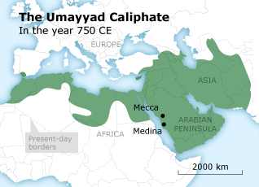
Umayyad dynasty 661-750
After Ali’s assassination, powerful Sunni generals seized power and founded the Umayyad Dynasty and moved the capital to Damascus in the old Byzantine and Roman Empires –ruled for 90 years
Governed from Gibraltar to India, biggest empire at the time
During the rule of the Sunni leaders, the Shias formed their own political component lead by imams instead of caliphs

Slide 14
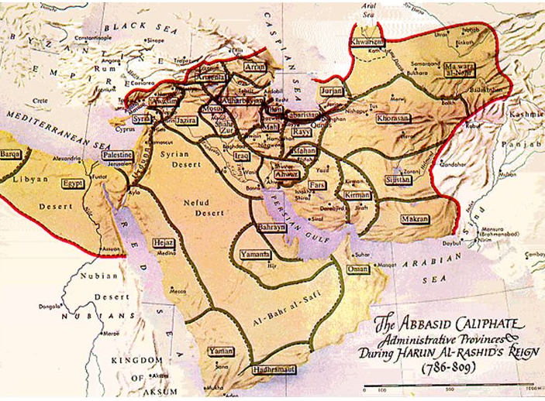
Abbasids 750-1258
Moved the capital to the ancient Mesopotamian city of Baghdad which became a center of culture –huge library, preserved and studied ancient Hellenistic and Roman works – perfected paper and made books more available
Usually thought of as the Golden Age of the Muslim World
Persians were able to keep their language and culture despite a strong Arab influence—they contributed with scholars, scientists and poets.
Problems collecting taxes, conquered by the Seljuk Turks who split the empire into sultanates, Crusaders, and finally fell to the Mongols
Mongols moved Silks Roads north and also destroying Baghdad’s library

Slide 15
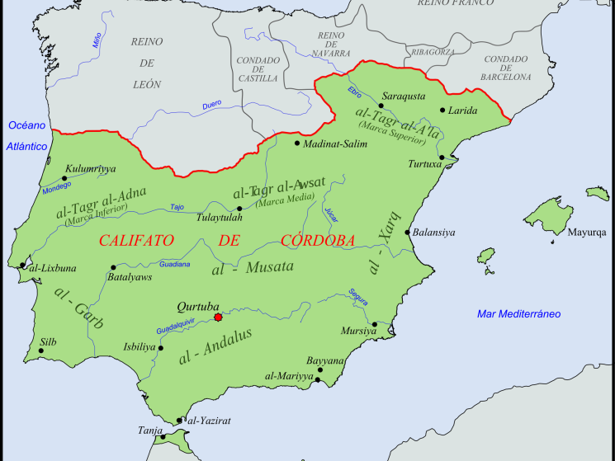
Rule in Spain
711, Muslim forces took over Southern Spain
City of Cordoba, became the Muslim capital in Spain
In the Battle of Tours, the French Charles Martell defeated the Muslim forces that tried to take France
Prosperity under Islam—trade using dhows brought from India and China—building of the impressive palace/fortress of the Alhambra
Ibn Rushd (Averroes), Maimonides –great philosophers on ethics

Slide 16
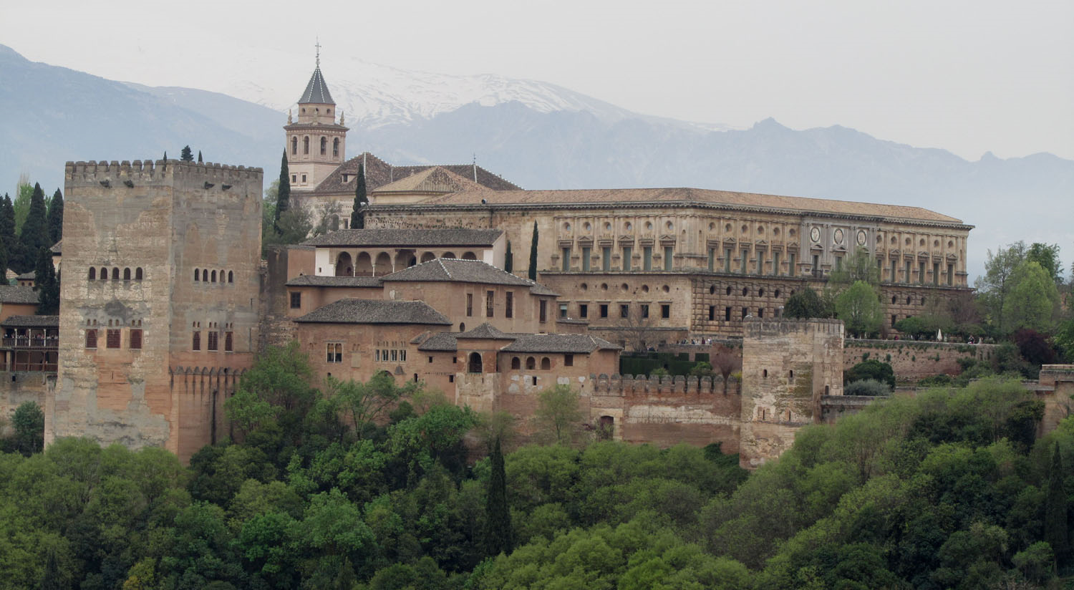

Slide 17
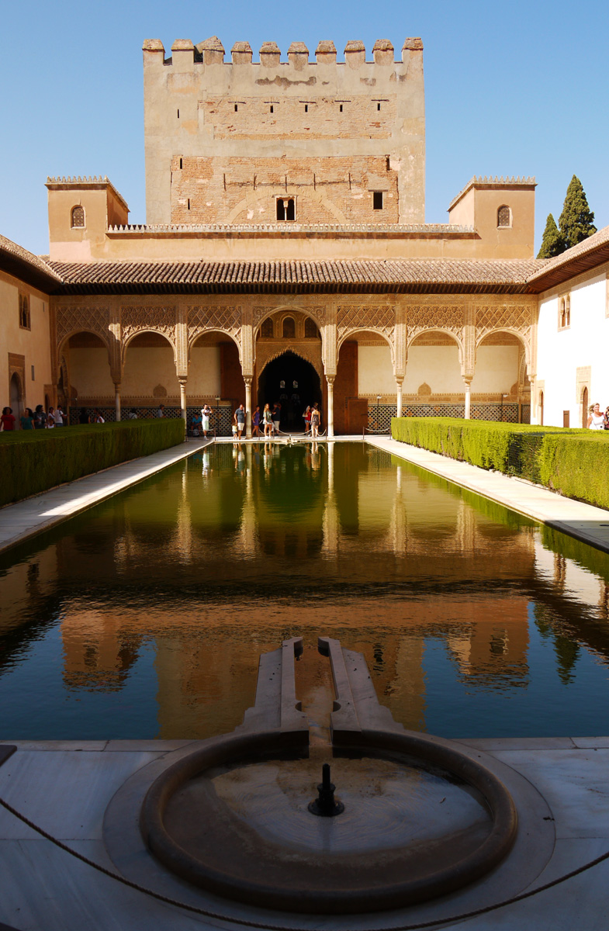
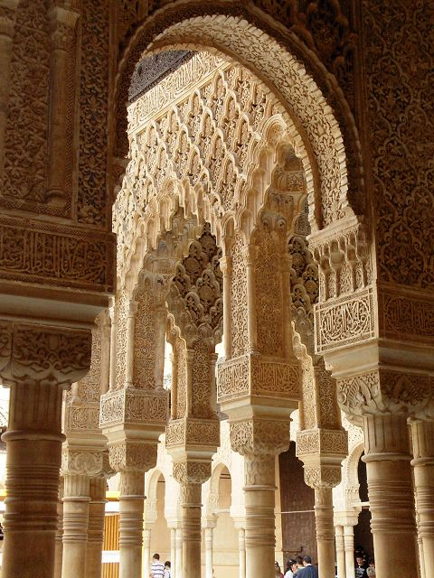

Slide 18
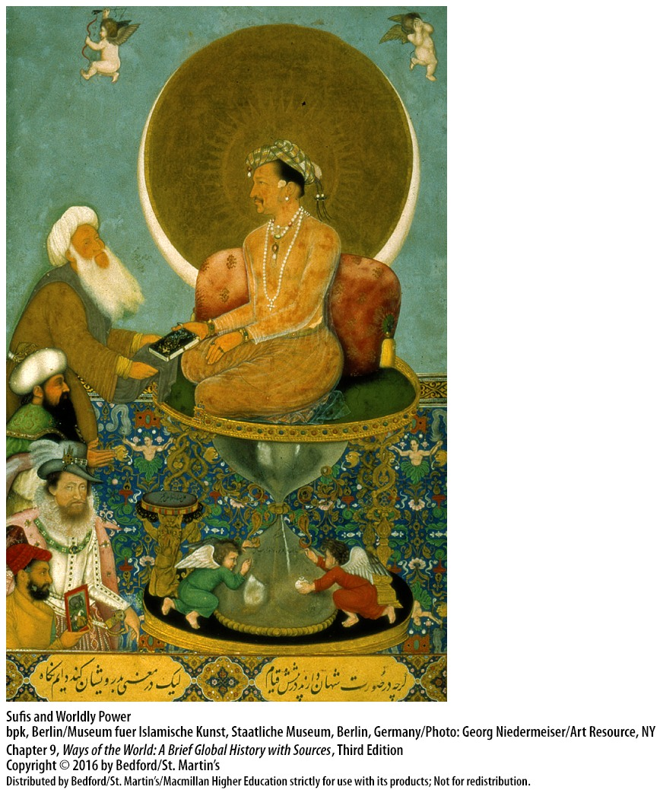
Other Aspects of Muslim Society
Shariah: code of law developed by scholars, behavioral code for daily life
Sufi movement: India, Persia—abstained from pleasures, focused on introspection rather than scholarship
Women: Muslim women had higher status than Christian and Jewish women, but dressed modestly. They could remarry, get cash, inherit, retain ownership, and even testify in court.

Slide 19
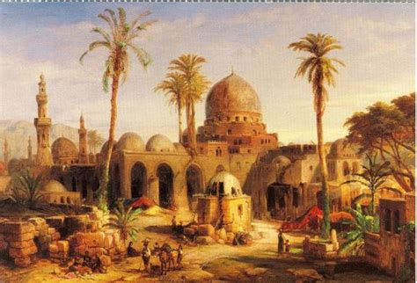
Legacy of the Golden Age of Islam
Due to the big trading centers such as Baghdad, Cordoba, Cairo, Bukhara, many people from all sides of the world brought their knowledge and it disseminated thru the Muslim World and later to Europe
Translation of Greek works
Brought Mathematics from India
China was a main focus
Medical advances in Egypt

