Slide 1
Classical China Ch. 5

Slide 2
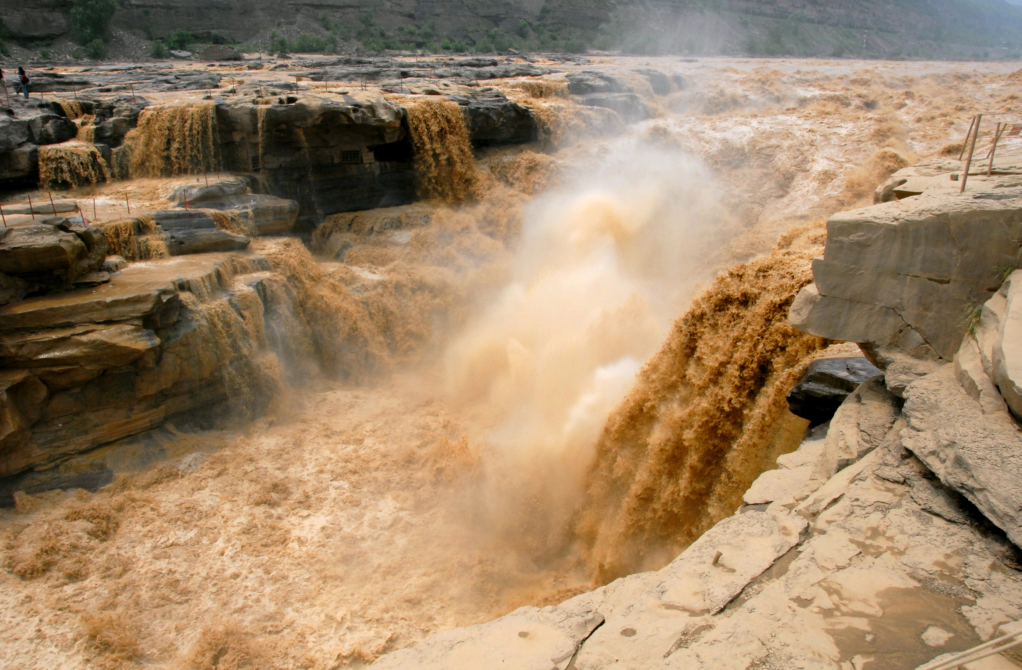
Early Chinese River Valleys
Early civilizations cropped up around the Huang He (Yellow River) and the Chang Jiang (Yangtze) Rivers.
Huang He called the “Yellow River” because the silt that is left behind after high water levels makes the water appear yellow in color.

Slide 3
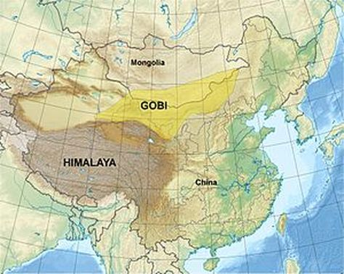
China’s Geography
Himalayan Mountains, India, Nepal, and Bangladesh to the Southwest
Gobi Desert to the North – 4th largest desert in the world
Taklimakan Desert to the West
Japan, Philippians, and the Pacific Ocean to the East
Harsh geographic landscape isolates China and trade was difficult in ancient times.

Slide 4
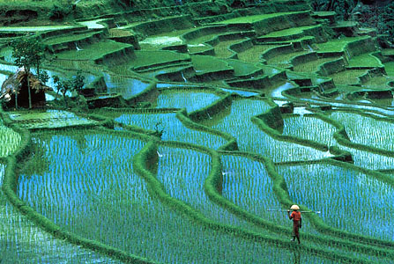
Agriculture in China
Only about 10% of China’s land is suitable for growing crops.
Most of this land is between the Yellow and Yangtze Rivers.
Loess – another name for the fertile silt left behind after river flooding.

Slide 5
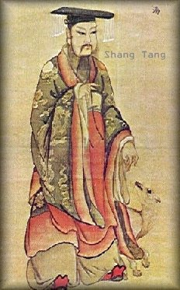
Early Chinese Dynasties
“Legend” tells us that the first Chinese dynasty came before Mesopotamia it was called the Xia Dynasty.
Xia Dynasty’s leader was named Yu, he was an early engineer and mathematician.
Yu developed a way to control the Yellow River’s flooding and irrigation for farmers
Shang Dynasty – first family of leaders in China to leave written records.
Built elaborate palaces and tombs.
Built city walls because they were constantly at war.

Slide 6
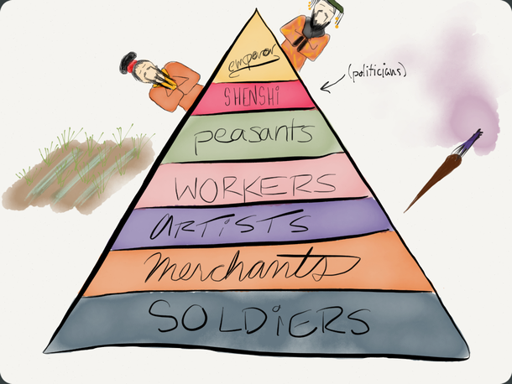
Early Chinese Culture
Value the group over the individual.
The most important virtue was to respect one’s parents.
Patriarchy – social structure where males take the lead role.
Class system
The Rich and Privileged (Nobles):
Lived in wood framed houses inside the city walls.
Owned land
Educated
The Farming Class (Peasants and Craftspeople)
Lived in mud huts outside the city walls.
Sent tribute to landholders for “protection”
Were NOT sent to school to be educated (vocational)

Slide 7
Early Religion in China
Believed that the spirits of family ancestors had the power to bring fortune or disaster.
Ancestors were not treated as gods but as something to be respected.
People of the Shang Dynasty believed they could communicate with their God(s) through Oracle Bones.
Oracle Bones – small animal bones or tortoise shells that priests wrote questions to their gods on.

Slide 8
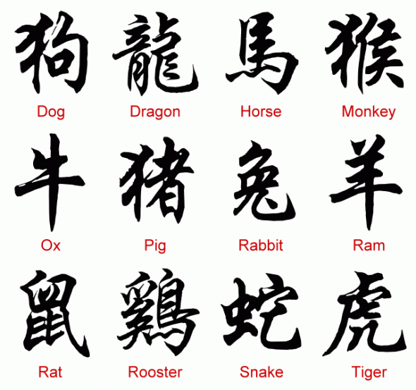
Early Chinese Writing
Used pictograms or symbols to represent ideas
Each symbol in Ancient China represented a syllable instead of a letter or complete word.

Slide 9
Importance
All parts of China, speaking different languages could read this early written language so it had a unifying affect on the nation.
This national written Chinese language made understanding and enforcing laws much easier throughout the vast nation of China.
One disadvantage was the people of China needed to over 1,500 characters of the language to pass as barely literate.
The language had over 10,000 unique characters

Slide 10
Zhou Dynasty and the Mandate of Heaven
Zhou people overthrow the Shang Dynasty
The justification for this was that the gods did not favor the Shang leader because of his poor leadership
A leader having divine approval from the gods became to be known as the…
Mandate of Heaven – a god given and approved, leadership appointment
God wants me to be your leader etc.
Becomes central view in Chinese Government

Slide 11
Dynastic Cycle
Dynastic Cycle – the pattern of rise, decline, and replacement of dynasties.

Slide 12
Early Chinese Government
The Zhou Dynasty establishes Feudalism
Feudalism – a political system which nobles, or lords, are granted the use of lands that legally belong to a king or emperor.
In return for the use of the lands knights and nobles pledge their military services and protection of the people in their estates.

Slide 13
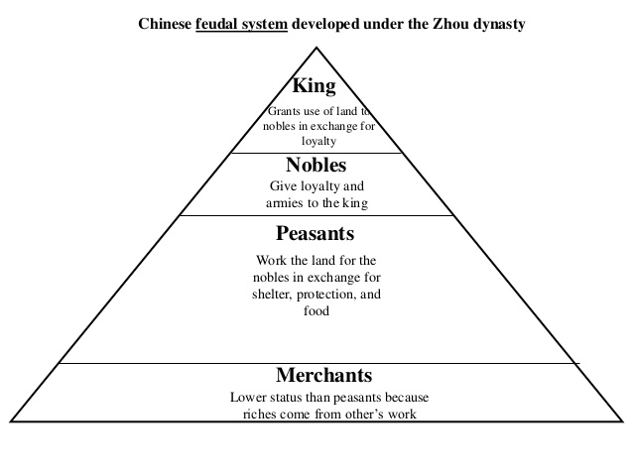
Lasted 8 centuries, constant warring between lords led to a decline in the Dynasty.

Slide 14
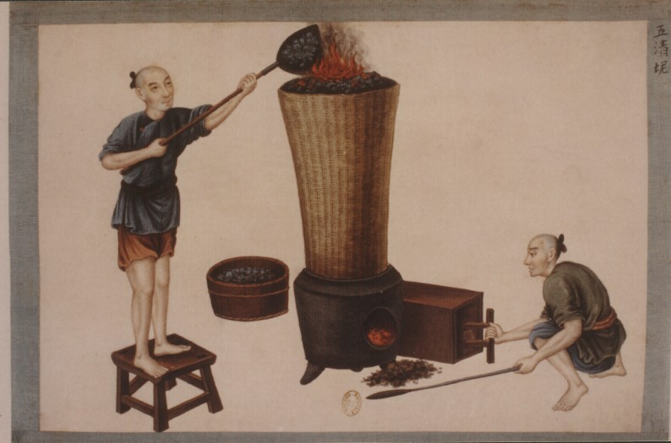
Chinese Technology
Roads and Canals to stimulate trade
Coined money was introduced
Blast Furnaces to produce iron.

Slide 15
Early Chinese Empire and the Unification of China
Mrs. Osborne

Slide 16
Confucianism
Confucius was the first great Chinese teacher.
He focused, not on spiritual or religious teachings, but on living a good life on Earth.
The teachings of Confucius are practical and conservative: they emphasize practical values such as honesty, loyalty, love of learning, and moral restraint.
Filial Piety- Respect for one’s elders and ancestors

Slide 17
Confucius and Government
Laid the foundation for Bureaucracy- a trained civil service, or those who run the government.
Education was very important
Confucianism was not a religion, but an ethical system based on the principles of right and wrong.
Foundation for Chinese government and social order
Spread to East Asia
Believed you should lead by example.

Slide 18
Lao-tzu and Daoism (Taoism )
The next great teacher to influence Chinese thinking was Lao-tzu.
He is known for his book of the teachings of Daoism called The Dao De Jing.
Unlike Confucius, he believed that less government was better.
Daoists regard nature as the greatest teacher
Daoists turn their back on the world and contemplate the Dao ( a mysterious force that rules the world).

Slide 19
Other Ideas
Some did not follow Confucianism or Daoism
The Yin Yang represents the forces of Light and Dark balancing one another.
The Yin is the feminine, passive force and the Yang is the masculine, active force.
Each contains a seed of the other.
That teaches that evil can contain a seed of good.
Book or oracles called I Ching used to solve ethical problems

Slide 20
Legalism
Legalists are the contrast to Confucianism and Daoism
Legalists believed powerful government was the key to restoring order in society
Gov’t uses the law to restore harmony
Founders= Li Si and Hanfeizi
Those who carried out orders well should be rewarded and those who disobeyed should be punished harshly
For example, anyone who was traveling outside of their village w/o a permit should have their nose and ears chopped off!

Slide 21
Japan
Followers of Shintoism, an ancient Japanese religion worship spirits who reside in natural places or objects. Ancestors were also regarded as divine.
Very similar to Buddhism from China and Korea
Buddhism was born in India but developed in China by monks and scholars.
Zen Buddhism, taken from China, took hold in Japan. Zen Buddhism advocated for meditation, self-discipline, and concentration as the path to Enlightenment
This is known as Zen.

Slide 22
Qin Dynasty
Replaced Zhou Dynasty in 3rd Century B.C. following Warring States Period
Shi Huangdi- ”First Emperor” of Qin Dynasty
Dealt with invaders and doubled China’s size. Wanted to unify China.
Crushed political opposition at home and was legalist
Murdered Confucian scholars and thinkers, burned “useless” books on philosophy and poetry. Medical and practical books were spared.
Established an autocracy: government that has unlimited power

Slide 23
Qin Dynasty Accomplishments
Highway network of 4,000 miles
Standardized weights, measurements, currency, writing, and law
Trade and agriculture flourished
Built the Great Wall of China to keep out invaders
Peasants worked or died, very harsh labor in which many died anyway.
Qin Dynasty came to an end in 202 B.C. after Shi’s son took over. Peasants rebelled gave way to the Han Dynasty.

Slide 25
Shi Huangdi: Villain or Hero?

Slide 26
Write a paragraph (5-7) sentences in which you determine if Shi Huangdi is a historical hero or villain. Use your notes or textbook for reference.
Due tomorrow at the beginning of class class

