Slide 1
Can you think about the following?
What things have remained the same throughout time? (continuity)
What things have changed throughout time?

Slide 2
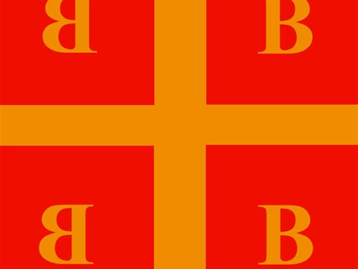
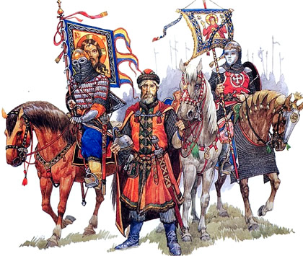
Ch 7. Byzantine Empire and Kievan Rus—600 Ce to 1450 CE

Slide 3
“Glory to God who has thought me worthy to finish this work. Solomon I have outdone you.“ – Justinian referring to the Hagia Sophia
What does this tell you about Byzantine Emperors?

Slide 4
Geography of the Byzantine Empire
The Byzantine Empire (Byzantium) included the lands in Greece, the Balkans, Anatolia, Syria, Palestine, Egypt, and northeastern Africa.
--What is an advantage of this location?
--What is a disadvantage?

Slide 5
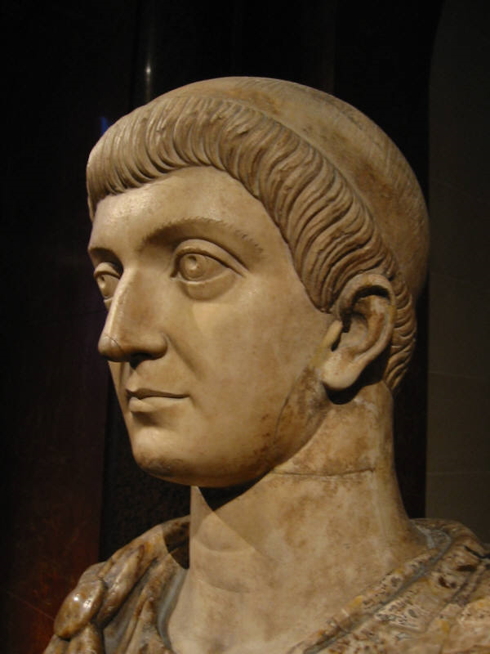
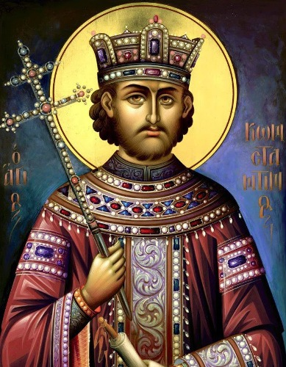
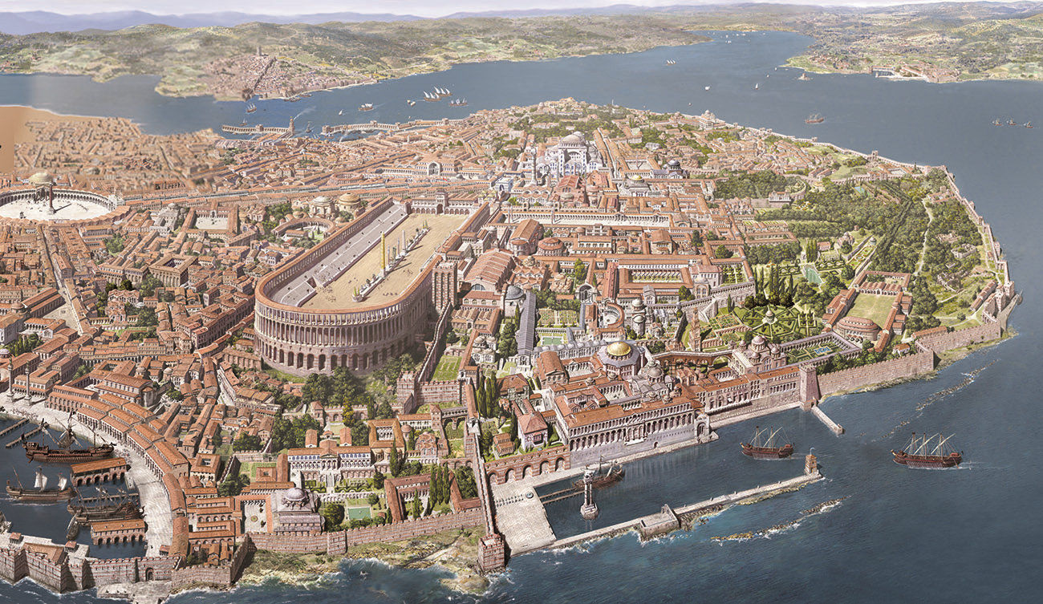
Early Byzantine Empire
Emperor Constantine accepted Christianity in 313 C.E. and relocated the capital of the Roman Empire to Constantinople (formerly known as Byzantium. Hence, the name Byzantine Empire)
Reason: the Eastern Part of the Empire was also the Wealthiest
It also allowed them to keep an eye on the enemies of the east: Persia, Nomadic Turks, Saracens (Arabs)

Slide 6
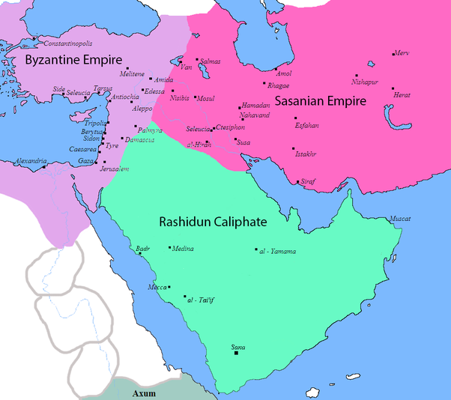
Enemies of Byzantium

Slide 7
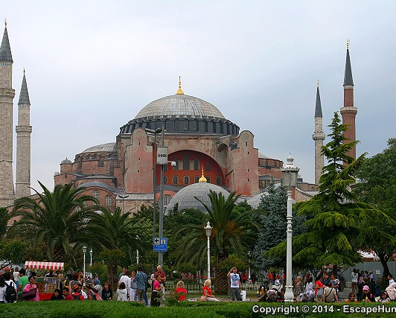
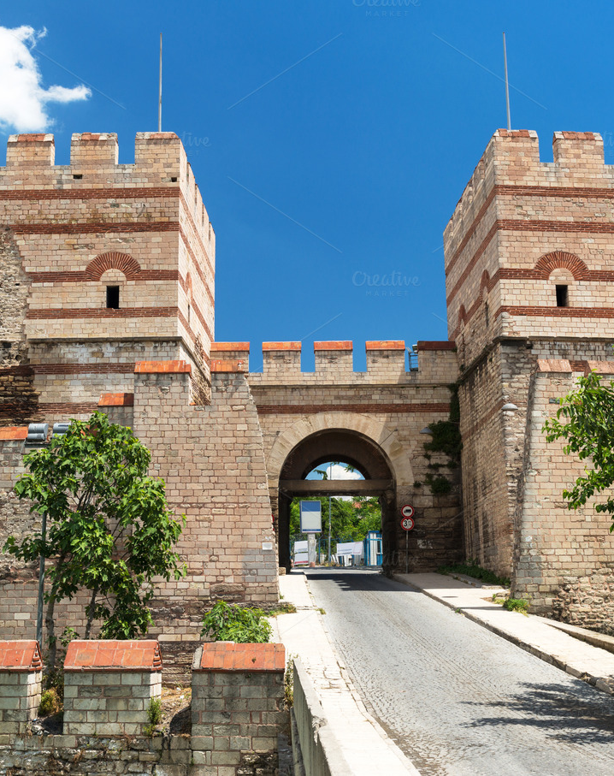
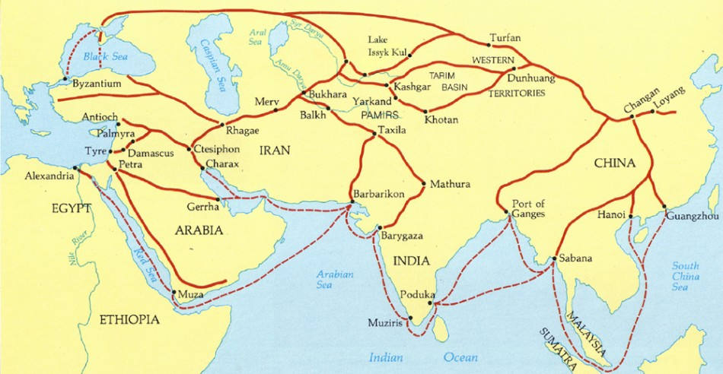
Byzantium- Constantinople
Constantinople was at the crossroads of Asia and Europe, was a major center of trade. It would become a wealthy city on its own right and to its own demise
The Young Byzantine Empire boasted roads and communication systems which connected them to the silk roads

Slide 11
Trade and wealth meant Constantinople had massive walls to fend off Germanic invaders looking for plunder

Slide 12
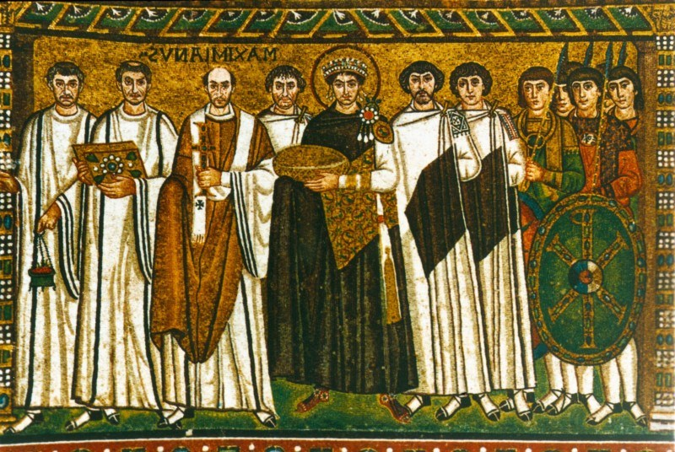
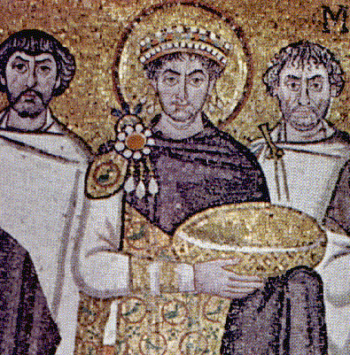
Byzantine Government
Tightly Centralized Rule of a highly Exalted Emperor
Caesaropapism: Emperor’s Important Roles in Ecclesiastical Affairs—they appointed the Patriarch of the Church –the empire was, therefore, a theocracy.
Emperor stood above the law
For this reason, the Emperor always tried to be popular with the masses: parties, religious monuments and holidays, hippodrome was extremely popular.
Large Bureaucracy trained in universities

Slide 13
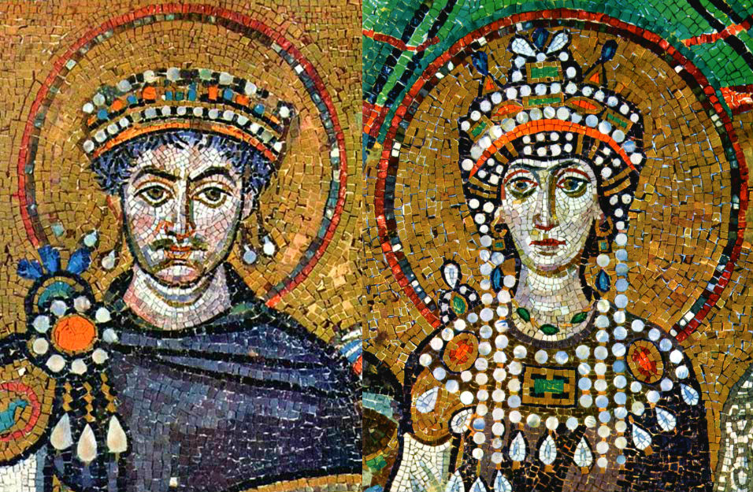
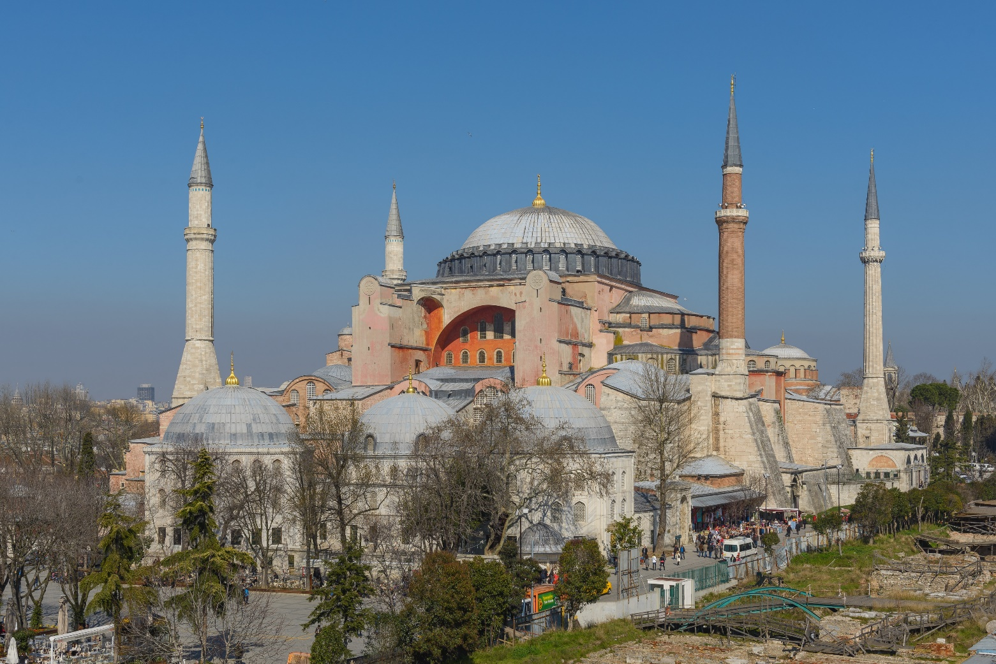
Justinian
Justinian (reigned 527 to 565 CE) was a very important emperor during the early Byzantine Empire
Theodora, his wife, advised him on political, religious, and diplomatic issues
Built great public works—Hagia Sophia, a cathedral that became a mosque following the Ottoman Turk’s Conquest of Constantinople, Exemplified architecture past and present.
Justinian Expanded Byzantine holdings, almost restored to the size the former Roman Empire
Published Corpus iuris civilis (body of the civil Law)

Slide 18
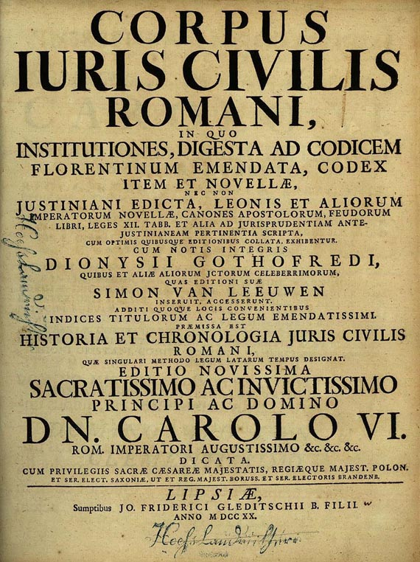
Justinian’s Code
Corpus iuris civilis is also commonly known as Justinian’s Code
A legacy of the Byzantines to the world
Ordered by Justinian
After a systematic review of all laws of the republic, Justinian codified Roman Law, keeping legal principles of ancient Rome.
Justinian’s Code has remained an inspiration for civil law codes.

Slide 19
"The precepts of the law are these: to live honestly, to injure no one, and to give every man his due. The study of law consists of two branches, law public and law private. The former relates to the welfare of the Roman State; the latter to the advantage of the individual citizen. Of private law then we may say that it is of threefold origin, being collected from the precepts of nature, from those of the law of nations, or from those of the civil law of Rome."
This excerpt from Justinian’s Code Exemplifies how the Byzantines…
A) Preserved Greco-Roman Culture
B) reformed the Roman Catholic Church
C) Split from Western Roman Legal Traditions
D) Established an Eastern Orthodox Church separate From Rome

Slide 20
Byzantine Emperors and More

Slide 21
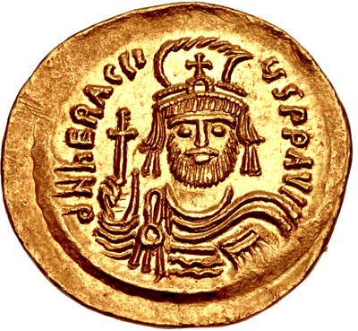
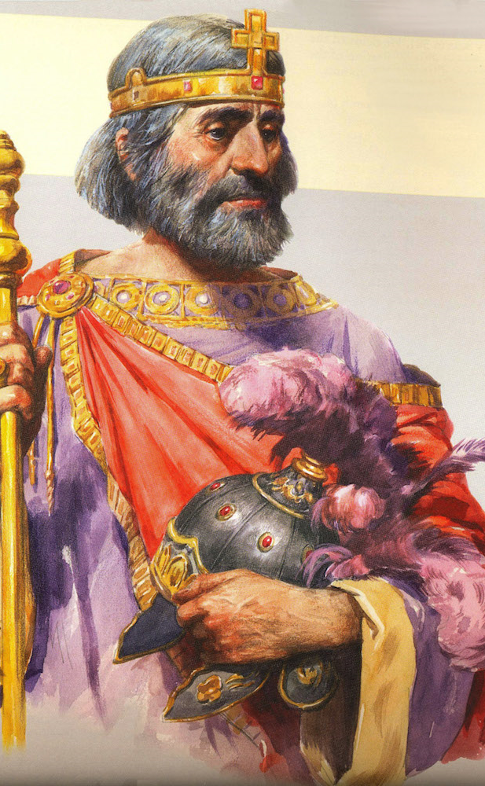
Heraclius (610 to 641)
Spoke Greek rather than Latin
Focused on fending off Islamic and Persian Forces
Able to assert superiority over the Persian Sassanids

Slide 22
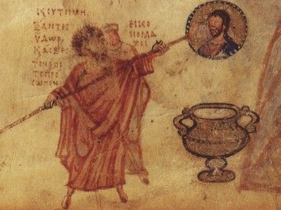
Leo III (717 to 740)
Part of the Syrian Dynasty
Was able to reclaim lost land against the Islamic Forces
Controversial: instituted policy of iconoclasm, the practice of opposing the veneration of religious images and icons.
Not popular with Monks and not accepted by the Popes

Slide 23
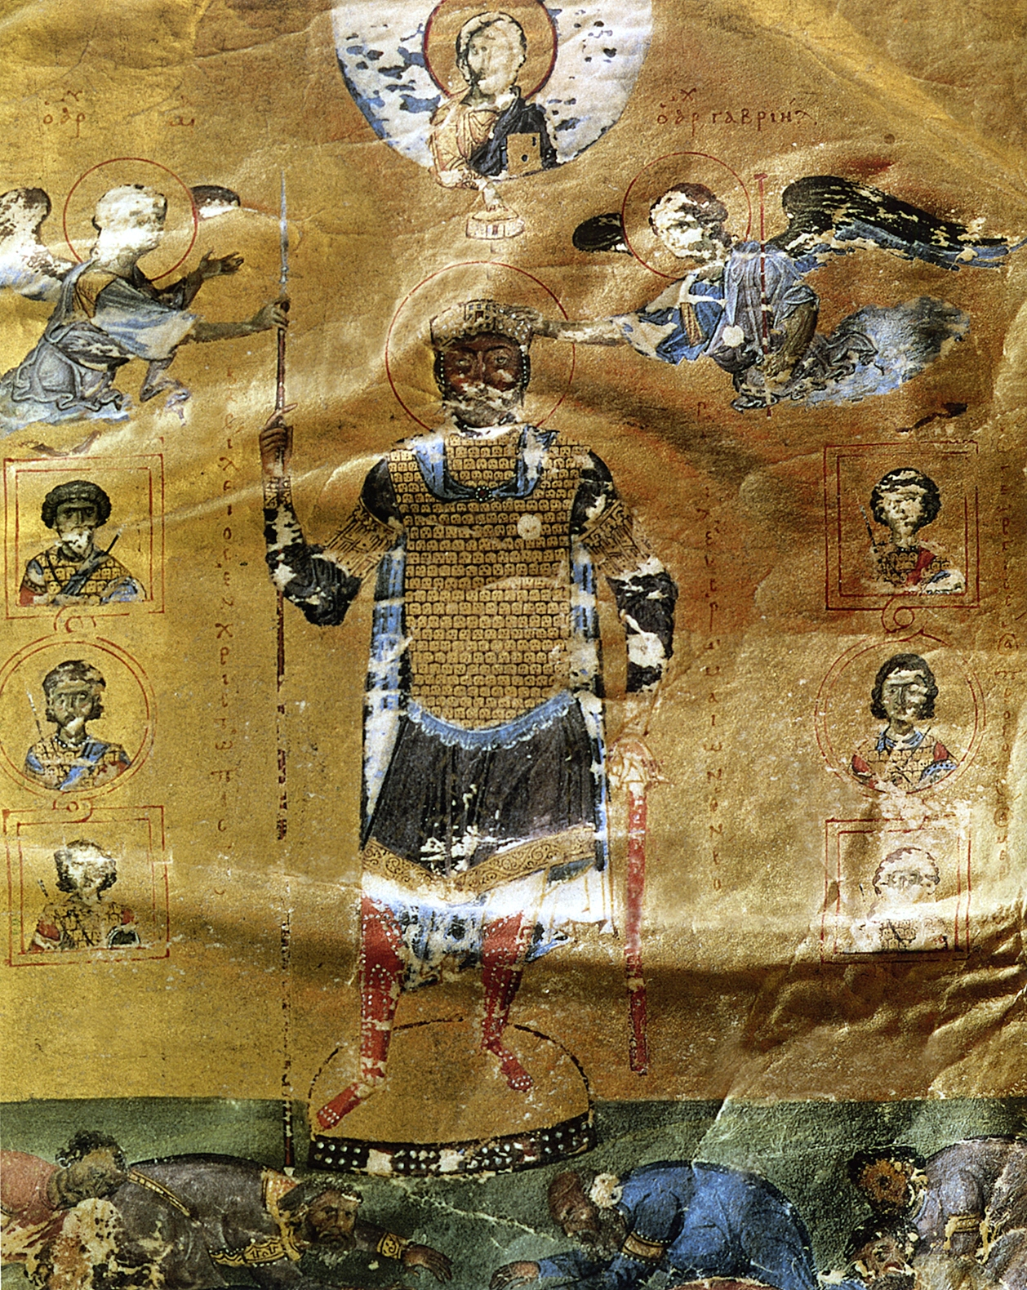
Basil II (976 to 1025)
Was as successful as Justinian on expanding the Byzantine Empire
Able to defeat the powerful Bulgars
Regained lost parts of Asia Minor

Slide 24
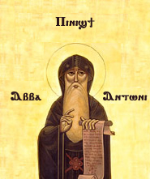
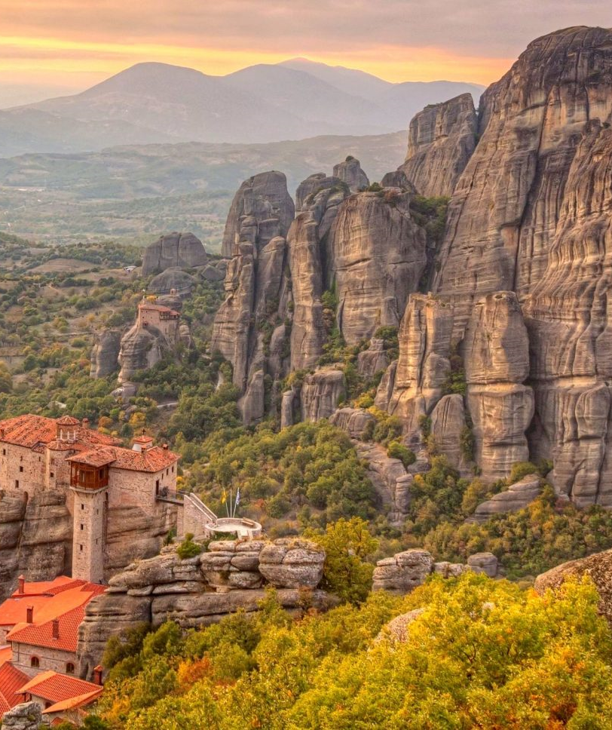
Byzantine take on religion
Byzantium was a Theocracy – no separation between the church and the state
Emperor appointed the patriarch, head of the church, and told him what to say during sermons :P
Monasteries– a community of monks and nuns, a.k.a ascetics— founded widespread throughout 300s and 400s, offered many services to nearby communities which helped them spread Christianity rather quick
Eastern Christian Monasticism was characterized by not having orders such as the one in western Europe

Slide 26
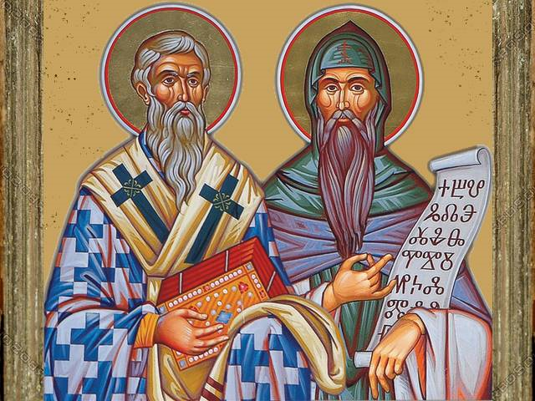
Cyril
Most successful missionary—worked on converting the Slavs
Created his own alphabet—based on the Greek Alphabet—his missionary work not only spread the word of God but also reading and writing (literacy)
Slavs adopted Eastern Christianity and Cyrillic Alphabet

Slide 27
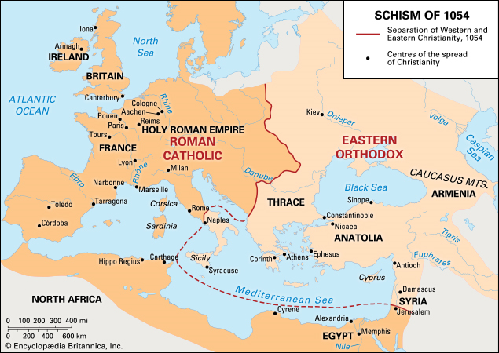
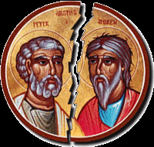
Conflict with Rome
Leo II’s controversy over his policy of Iconoclasm clashed with Rome
Big Disagreement over Pope’s authority and if Rome was the center of Christianity
1054— Schism, separation or split, happened between the East and West—Pope Leo and Patriarch Michael excommunicated one another signifying the completion of the schism
West: Roman Catholic
East and Russia: Eastern Orthodox

Slide 29
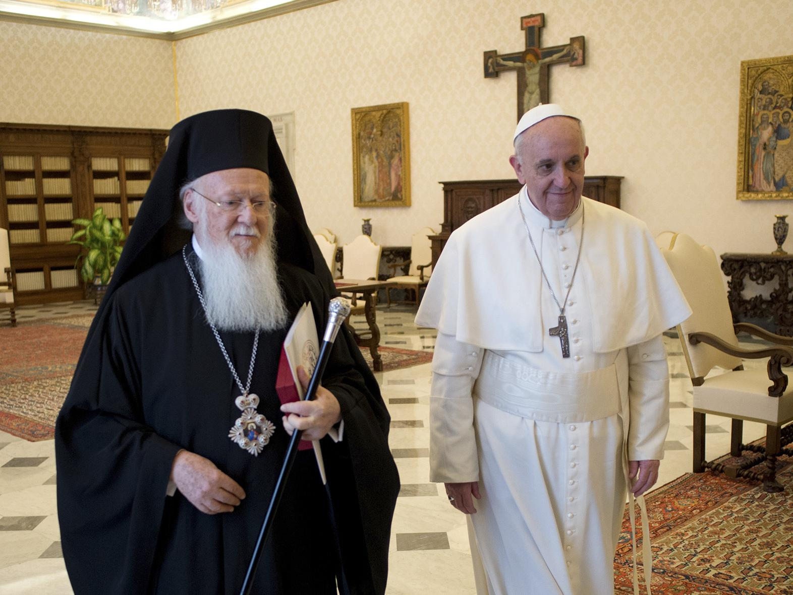
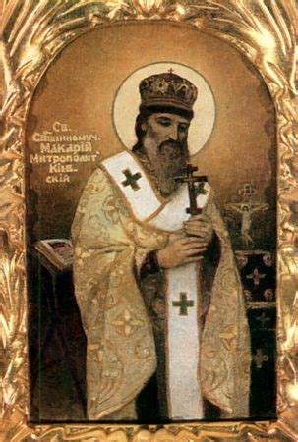

Slide 30
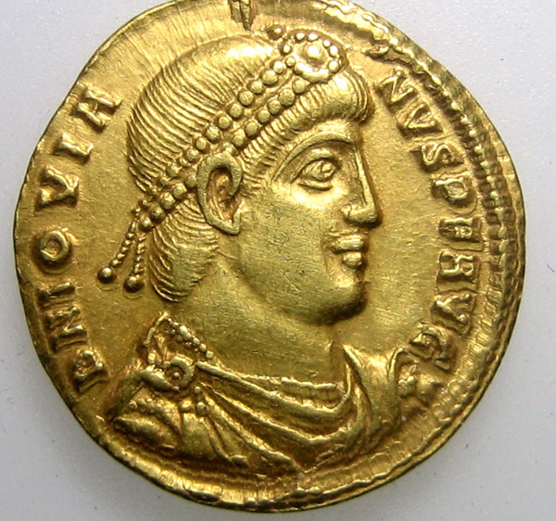
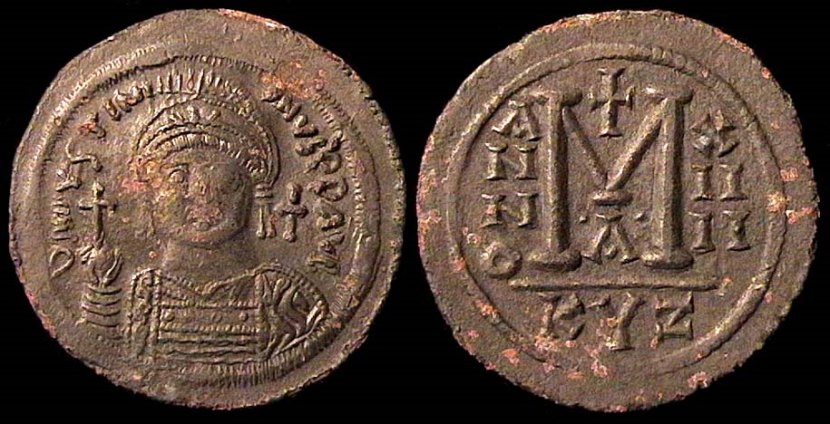
Trade and Prosperity
Strong economy—helped it last for 1000 years
Constantinople’s location key factor, others used their currency the bezant (example of cultural diffusion and power)
Mare Nostrum (our sea)—the Byzantines controlled the Mediterranean, a Strong Navy ensured security for merchants
Government regulated industry—anti-monopoly laws
Strong Agricultural Component— Many Byzantines worked on the Latifundia around the Empire—supported large cities, ensured supplies of raw materials and food which in turn encouraged trade
Government also regulated amount of land a person can own and would help peasants from time to time break bonded labor

Slide 31
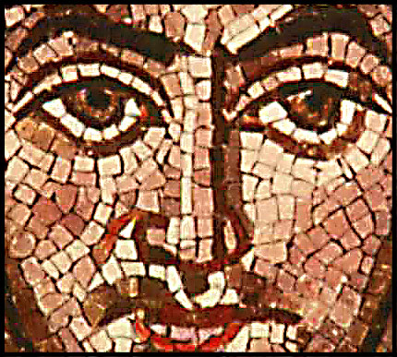
Byzantine economy and society
Craftsmen were highly respected for their glassware, gems, jewelry, and mosaics
Silk Industry (obtained thru cultural diffusion from China) became important in the Byzantine Empire and the Government controlled it
Theme System—if peasants joined the military they could get their freedom
Regardless of efforts to stop large owner influence and power, the landowners became really powerful and resisted tax collection which gradually weakened the Byzantines

Slide 32
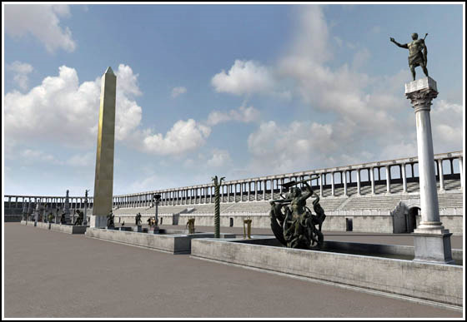
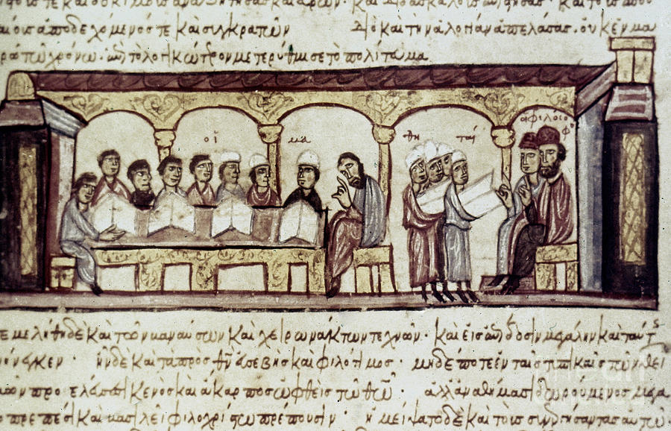
Arts, Education, Life
Greek Replaced Latin as the Language of the Educated Elite
Literature and Art focused on Religion, illuminated manuscripts
Schools opened to educate on math, philosophy, medicine and the law—Modeled after Classical Greece’s Schools and History
UC opened on 850 –focus on bureaucracy
Preservation of Greek Culture, Legacy to Modern Society as many of that was taken back to Western Europe Via Crusades
Hippodrome main source of fun on many great cities, large festivals organized by the Emperor

Slide 34
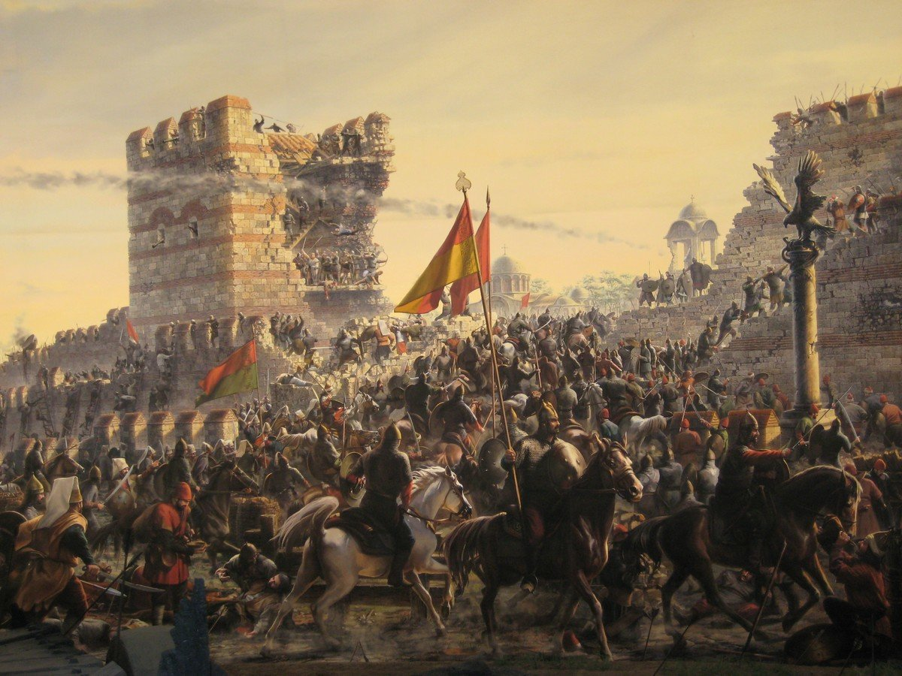
Fall of Byzantine Empire
In 1071, the Byzantines lost most of Anatolia (where their main crops were by this time) which led to their ultimate demise (no food source).
Invasions from Muslims
Emperor Alexius I called for a Crusade but Crusaders Sacked the city in the 1200s.
Seljuk Turks invaded from the East and Conquered Constantinople in 1453.
Many Byzantines left for Italy in the 15th century, taking with them their Greek Culture which would later influence the Renaissance (rebirth of Greco-Roman Culture).

Slide 35
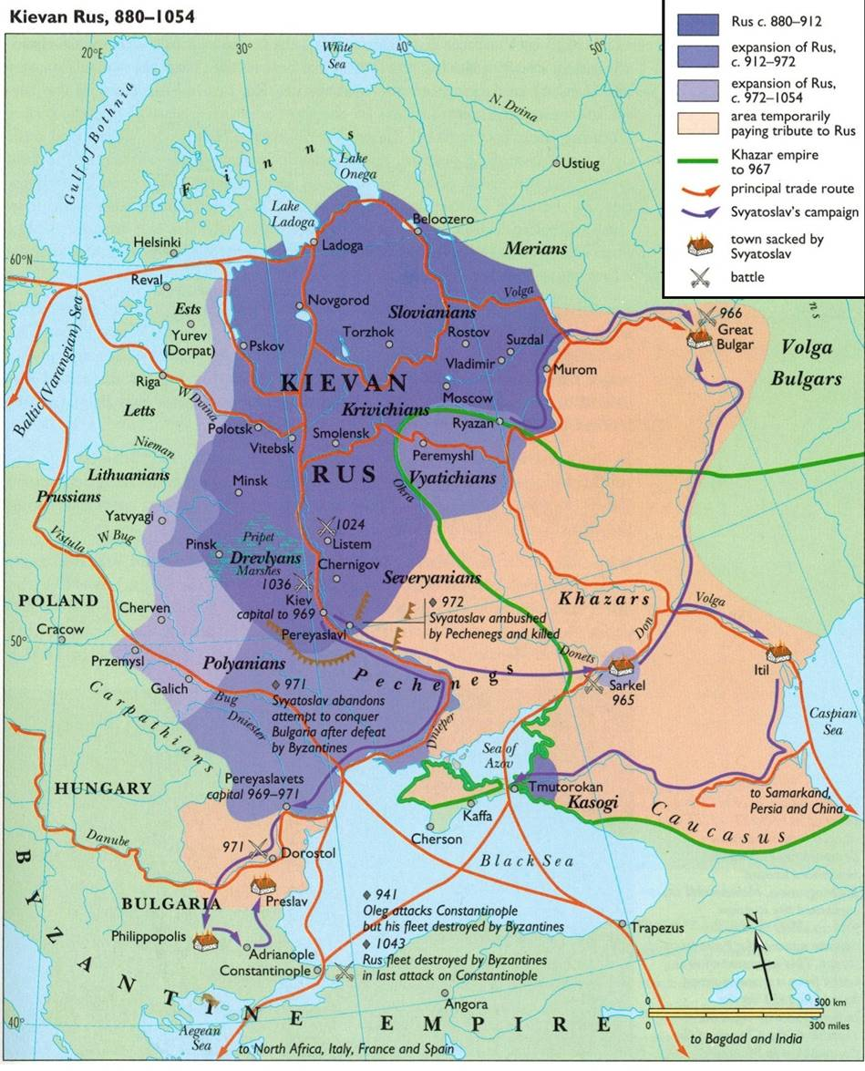
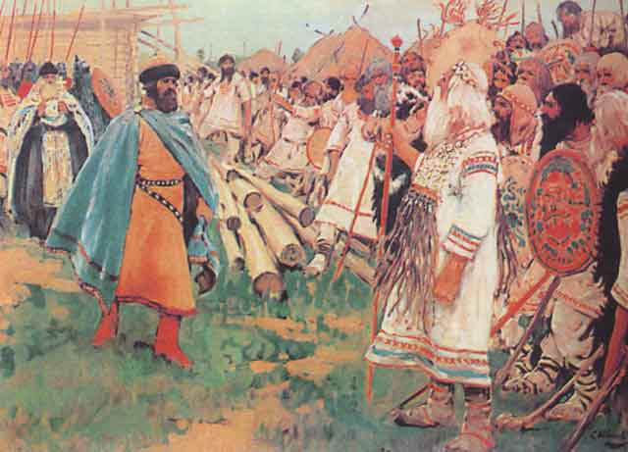
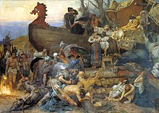
The Kievan Rus

Slide 36
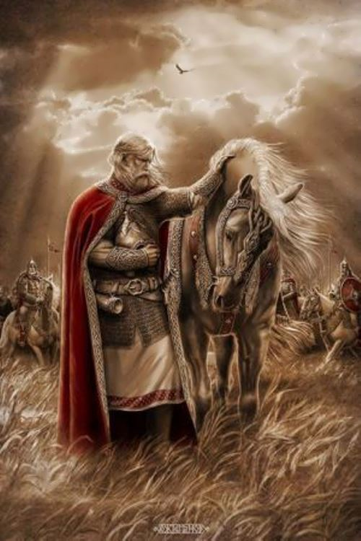
The Kievan Rus
Environment: Slavs were tribes on hunter-gatherers who lived in the Eastern European Steppes
Around 800 CE, the Vikings expanded into Slavic Territory through river trade routes, especially along the Dnieper River.
By 900 CE, Vikings known as the Rus or “the roamers” ruled over the Slavs – Oleg founded the Kievan Rus – a collection of city states governed by a grand prince elected by Boyars (Viking Noblemen).

Slide 38
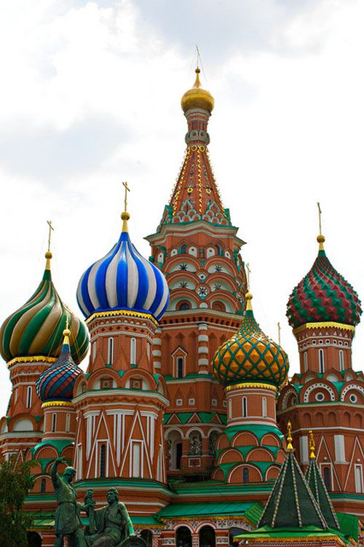
Conversion to Christianity
Byzantines sent missionaries to the Kievan Rus in order to seek control over them before they could become potential foes
Prince Vladimir I The Great converted in 989 CE after marrying the Sister of the Byzantine Emperor
Byzantine advisers soon made it to Kiev
Onion-dome Churches, Monasteries represent Byzantine Influence
However, Peasants still followed the Old Religion for centuries to come

Slide 39
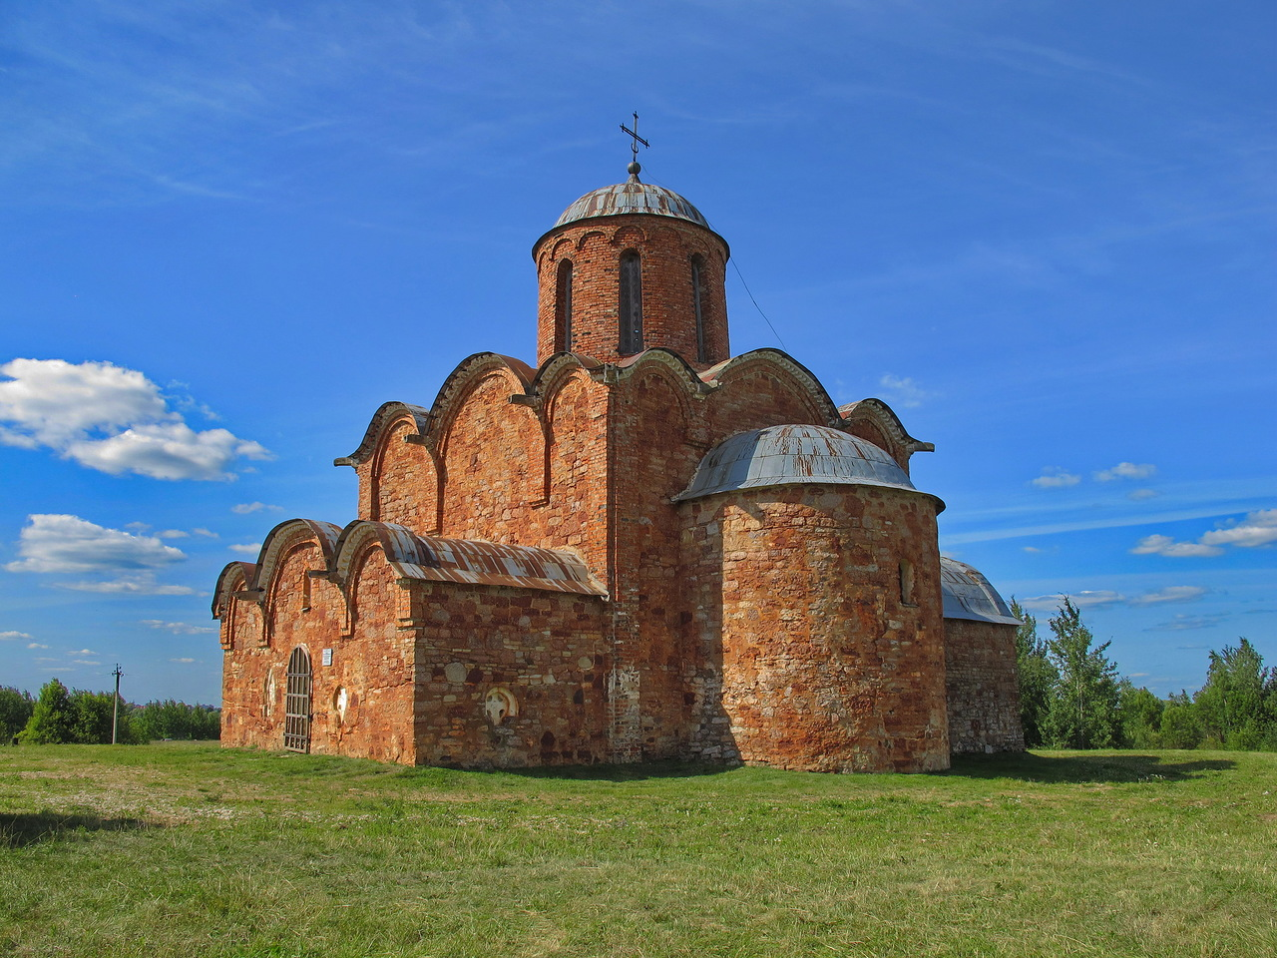
Golden Age and Decline
Yaroslav the Wise, Vladimir’s Son, was able to codify the legal system—Russkaya Pravda or Russian Justice – and also promoted education
Due to shortage of resources (except timber, hide, and honey) they traded on slaves—and when Constantinople refused, they raided it.
As the Byzantine declined and Kiev found it difficult to reach Constantinople, the power of the city declined sharply—by 1200s they were being raided by the weaker northern Russian cities and Pechenegs – and then by the Mongols
Novgorod—legendary and wealthy city—trade capital of Northern Russia—800 to 1300—but would be conquered later on.

Slide 40
Create Poster or rhyme
Create a poster or a rhyme advertising one aspect of the byzantine World to the slavs.
Your poster or rhyme can be about to either one of the following terms:
Justinian’s Code, Bezant, Christianity, Iconoclasm, Hippodrome, Cyrillic alphabet, monasterie.

