Slide 1
Topic 1.6- Developments in Europe: The Middle Ages

Slide 2
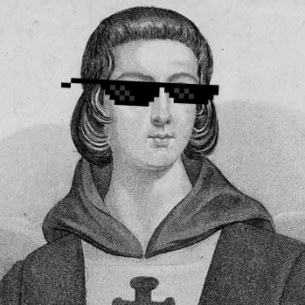
What does this tell you about medieval Europeans?
I should not wish to be Aristotle if this were to separate me from Christ.
-Peter Abelard, French philosopher, theologian, and logician, Letter 17 to Heloise, his lover(1141)

Slide 3
Essential Question
How did the beliefs and practices of the predominant religions, agricultural practices, and political decentralization affect European society from c. 1200 to c. 1450?
Outline:
Political Decentralization- Formation of Monarchies, Feudalism, and the Manorial System
Religious practices shape societies in Europe
Europe was dependent on free and coerced labor: Serfdom

Slide 4
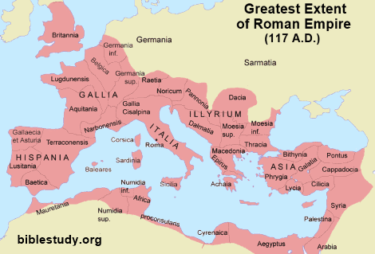
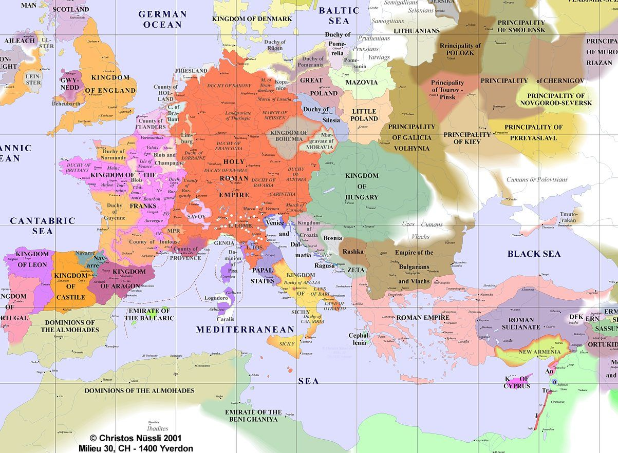
Roman Empire demise brings the “dark ages”
After the Fall of Rome in the 5th and 6th centuries, Europe entered a period known as the “dark age” because:
Intellectual endeavors stopped
Smaller, less stable kingdoms replaced the Roman Empire
Development of Vernacular Languages evolved from Latin and Germanic (Spanish, French, Italian—English, German)
Trade interrupted due to Viking, Muslim, and Hunnic raids

Slide 5
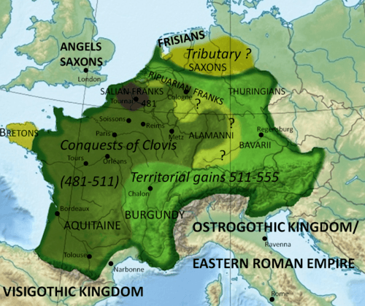
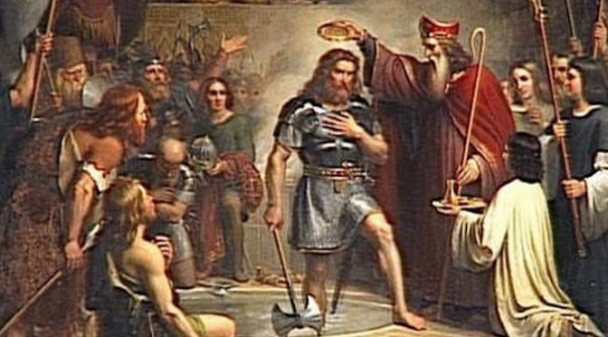
Germanic Kingdoms and Feudalism
Germanic Kingdoms (the Franks in France for example) spawned through Europe
People were more loyal to their tribe/family than to citizenship to a kingdom or empire -- many were only united by religion such as Clovis, Frankish rulers that united the Franks and converted to Christianity and received blessings from the Pope
However—they needed real power
These Kingdoms developed a decentralized form of government known as Feudalism – exchange of land for protection and loyalty.

Slide 6
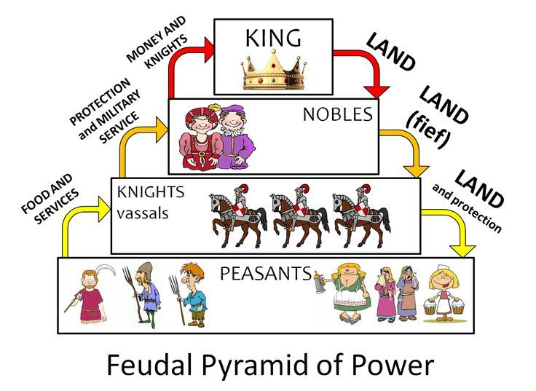
How did Feudalism function?
Feudalism was a system of mutual obligations. It allowed King to decentralized control as Lords oversaw running their land.
Monarchs (kings) granted land (fiefs), to lords (vassals)- they must protect the king.
Lords granted land to knights, which pledged to fight for their Lord guided under the Code of Chivalry
Lords provided protection to peasants because they worked the land, livestock, and obeyed them.
Wealth was based on land (fiefs), not in cash.

Slide 7
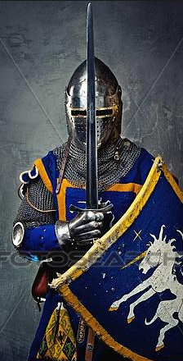
Code of Chivalry
To fear God and maintain His Church
To serve the liege lord in valor and faith
To protect the weak and defenseless
To give succor to widows and orphans
To refrain from the wanton giving of offence
To live by honor and for glory
To despise pecuniary reward
To fight for the welfare of all
To obey those placed in authority
To guard the honor of fellow knights
To eschew unfairness, meanness and deceit
To keep faith
At all times to speak the truth
To persevere to the end in any enterprise begun
To respect the honor of women
Never to refuse a challenge from an equal
Never to turn the back upon a foe

Slide 8
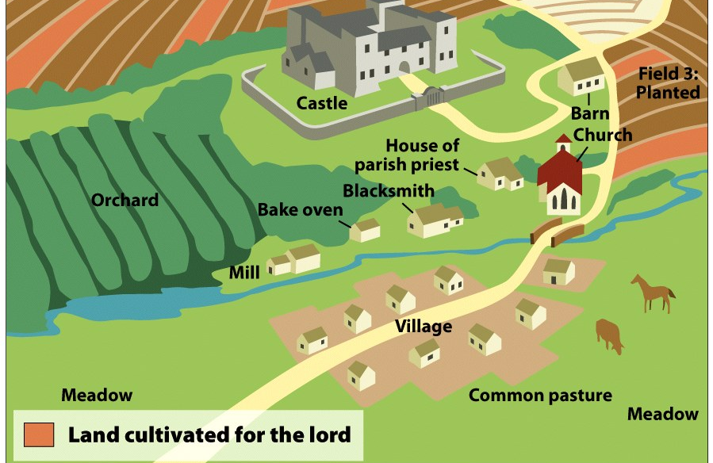
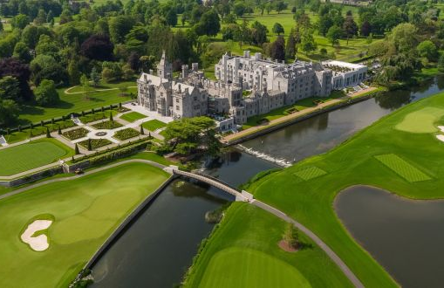
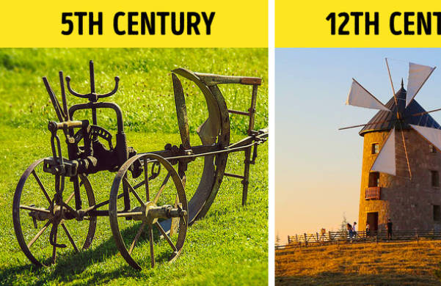
Manorial System (manorialism)
Large estates (fiefs) were referred as manors
Manors were self-sufficient: they provided everything people needed (food, resources, and even a local chapel),
Manors were limited on trade and outside contact
Technological advances of the time were slow:
Three-field system—crops rotated through three fields- 2 in use, on rested so it could replenish.
Plow and Windmills were new, albeit slow, improvements on technology.

Slide 9
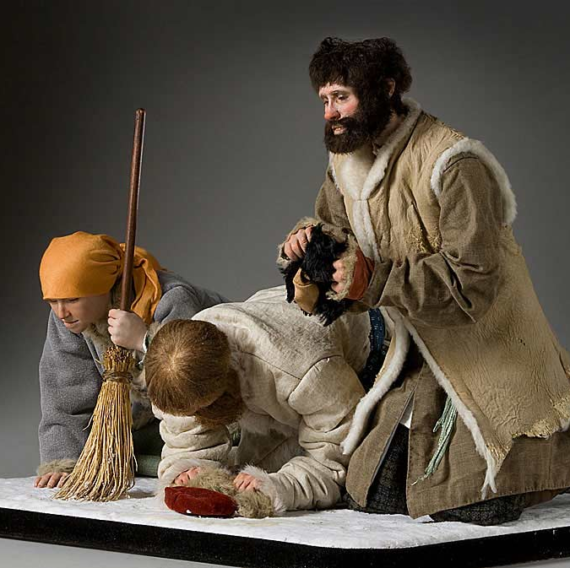
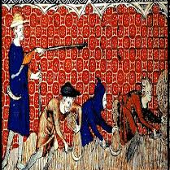
Serfdom
Serfdom was a system of indentured labor (basically debt bondage).
Serfs (peasants) were bonded land they worked and spent most of their lives in the manors.
Had to ask their Lord for permission to marry, have children or travel.
Most serfs only travel as far as 20 miles away from the manor in their lifetime
Their children became serfs.

Slide 10
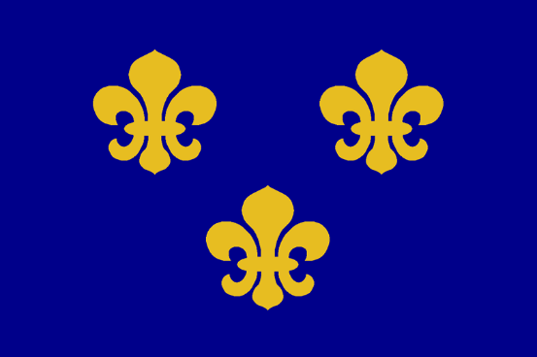
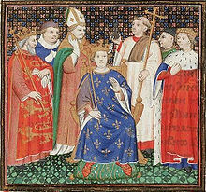
Political Trends in the Later Middle Ages
Monarchies hired their own armies and bureaucrats to work for them, not for their country.
France under King Phillip II was the first to develop a bureaucracy – under Phillip IV in the 1200s, the Estates-General met to advise the king.
Estates-General was formed by the estates, or classes, in France: clergy, nobility, and commoners. Only the commoners paid taxes. As a result it had little power and felt little responsibility to France.

Slide 11
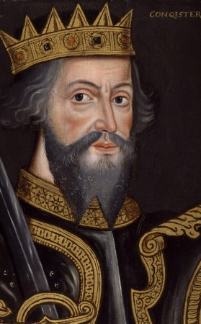
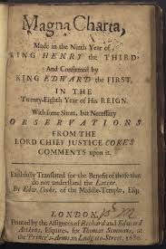
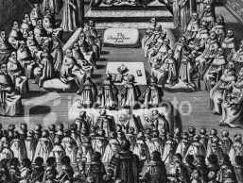
Developments in Norman England
Normans were French-settled Vikings who under William the Conqueror conquered England in 1066. They mixed with the Anglo-Saxons to create modern English people.
They used a very strict Feudal system. People disliked this.
By 1215, the English nobles forced King John to sign the Magna Carta, requiring the king to respect rights such as trial with a jury.
In 1265—the English Parliament was formed with a House of Lords (nobles and church) and House of Commons (wealthy townspeople).

Slide 12
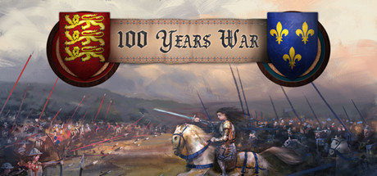
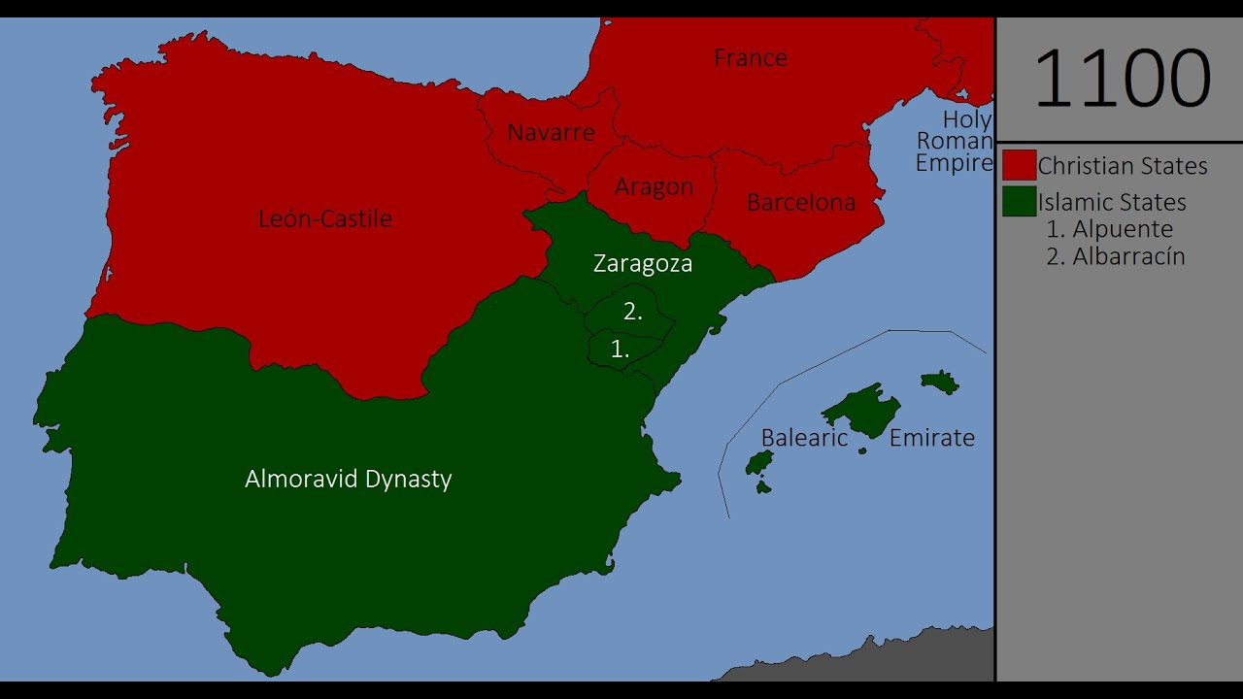
HUNDRED years’ war 1337-1453 and Spanish Reconquista
Bitter rivalry between England and France
This conflict developed a sense of nationality – people began to identify as “French” and “English” despite speaking different dialects.
Widespread use of gun powdered weapons
In the Reconquista, the Spanish sought to reconquer land lost to the Muslims – completed in 1492.

Slide 13
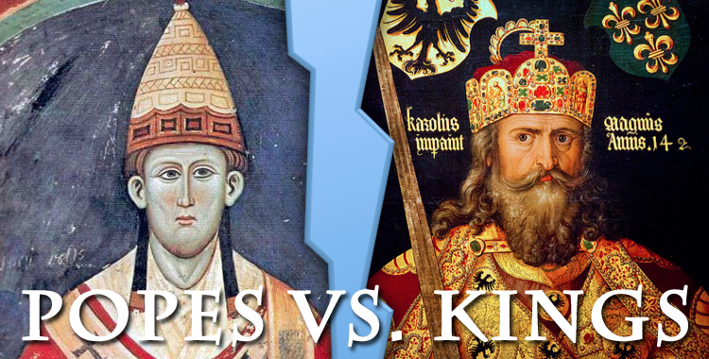
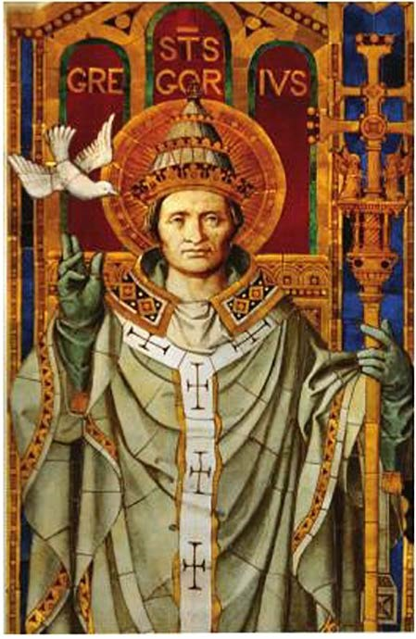
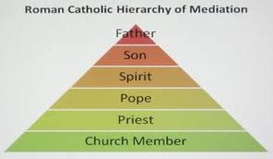
The Roman Catholic Church
The Roman Catholic Church was the most powerful institution during the Middle Ages.
Popes were the highest authority followed by the clergy
Monks, and local priests.

Slide 14
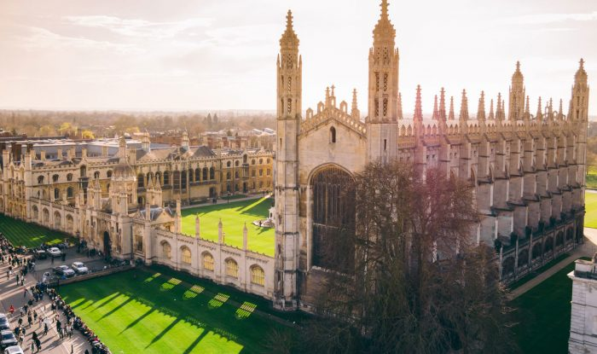
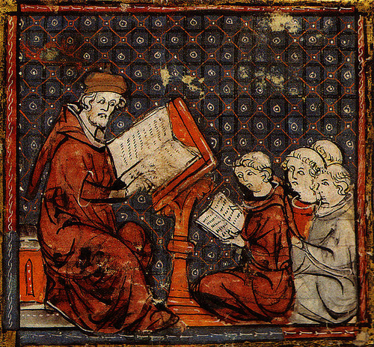
Influence of the church
First Universities were established by the Church (like Cambridge or Oxford)
Church provided basic education to all
Church and the State—the Pope held great authority, could pressure Monarchs by not providing services to serfs.
Church supported charities, but many Churches and Monasteries became corrupted and wealthy by charging people money for prayers.

Slide 15
Crusades
Crusades, military campaigns in the Mideast between 1095 to 1200s. European Christians sought to regain control of the Holy Land
Causes:
Primogeniture laws allowed only the eldest to receive wealth and land, this left a generation without inheritance.
War could be a distraction to these restless men who caused trouble in their countries.
Merchants wanted access to trade routes.
News of Seljuk Turks harassing Christian pilgrims
The promise going to heaven attracted many recruits.

Slide 16
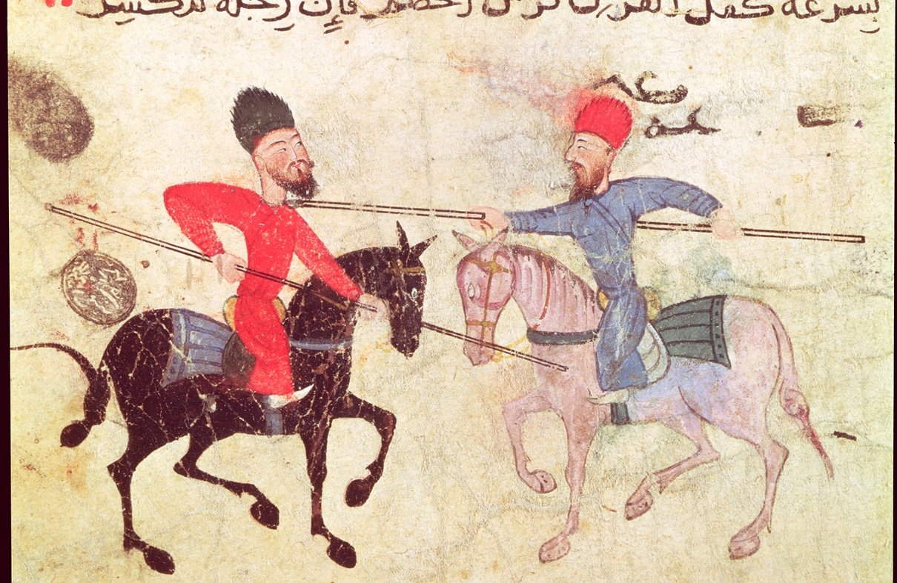
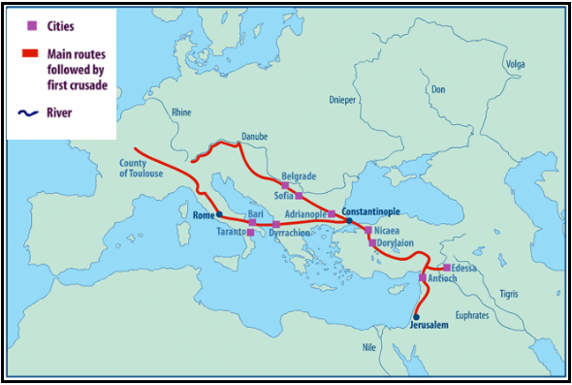
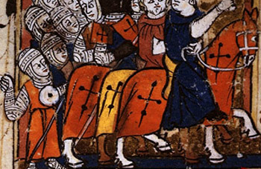
1st Crusade
Orthodox Patriarch in Constantinople appealed to Pope Urban II
Clear Victory for Christendom in July 1099 they took Jerusalem
However, in 1187, the Muslims under Saladin retook the Jerusalem
Effect on Europe: Crusaders realized Muslim lands had a better standard of living than Europe, and
Europeans began demanding Middle Eastern goods– trade increased bringing more wars.

Slide 17
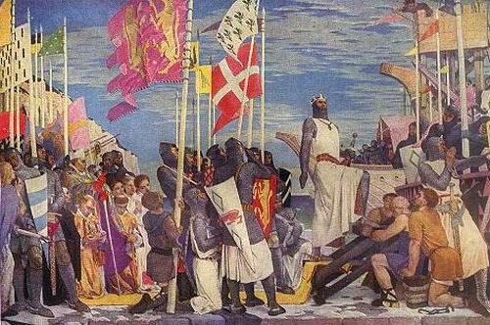
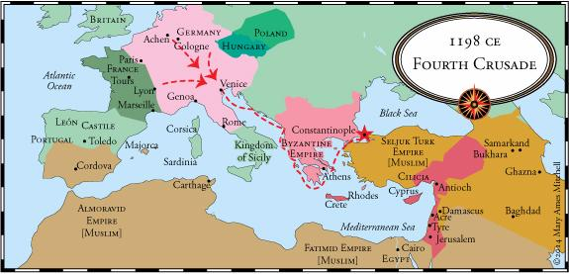
4th Crusade 1202-1204
Venice, Italy, had a contract to transport the crusaders to the Middle East, but as they were not paid in full, they didn’t take them.
Venetians persuaded the Crusaders to sack Zara, Italy and then Constantinople.
They never arrived to fight– destroyed Constantinople, took many treasures

Slide 18
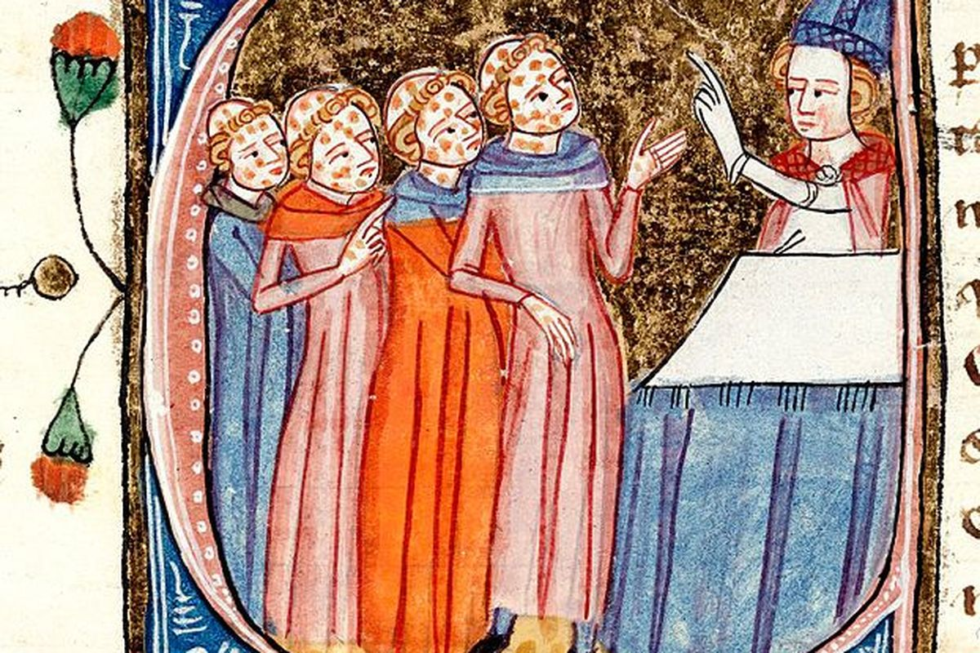
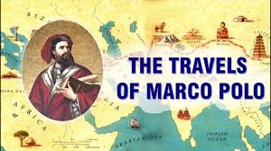
Economic and Social Change
By the late Middle Ages, European society experienced change because trade increased.
Marco Polo—Venetian Trader who travelled to the Mongol Empire (China) and wrote vivid descriptions of the Mongols, his travels sparked an interest in Asia.
Social Change—Social Pyramid changed in Europe as the middle class, or the bourgeoisie, or burghers, began to grow. (Merchants, Craftspeople, Small landholders).
People moved into the cities—the 14th Century Black Death killed 1/3rd of the population, increasing the value of labor of serfs who moved into the cities to look for better wages, abandoning the manors and eventually making feudalism obsolete
Jews and Muslims were discriminated. Anti-Semitism, hate of Jews, was widespread. In fact, Jews were expelled by Western European countries and moved to Russia and Poland.

Slide 19
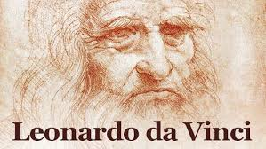
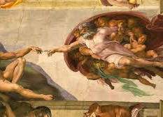
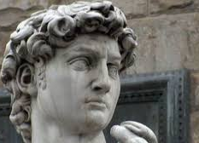
Renaissance
The expansion of trade, agricultural surplus, and the rise of the middle class created a spark of creativity in Europe.
Renaissance—the revival in the interest of Greco-Roman literature, art, culture and civic virtue. It began in Northern Italy.
Humanism—people focused more on human achievement than God– a secular society.
Printing Press invented by Johannes Gutenberg initiated a revolution in the spread of information—reduced the cost of books.

